Slide 1

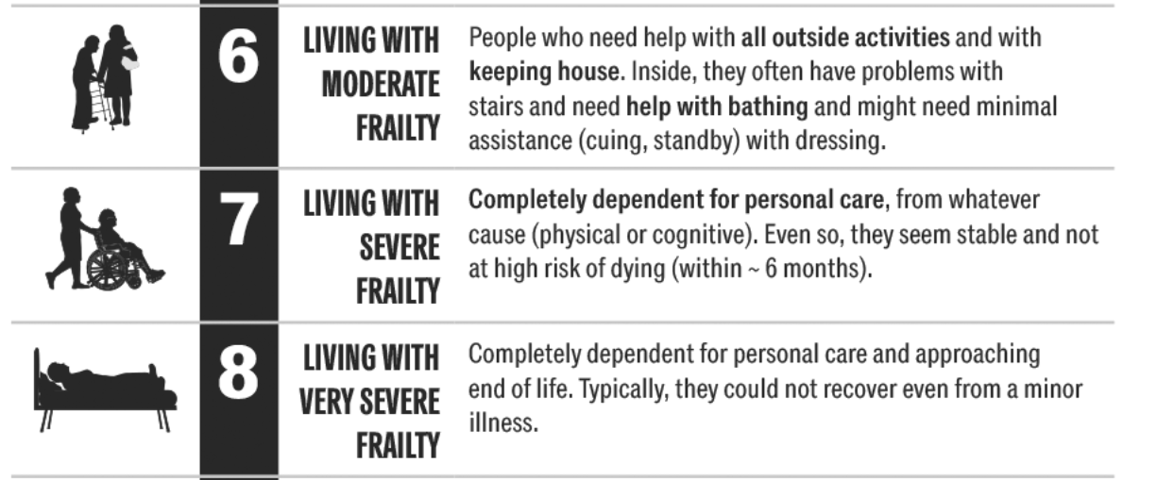

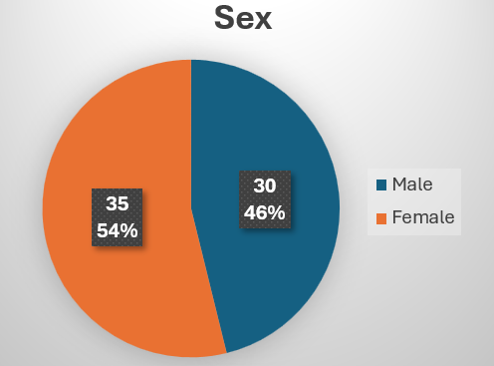
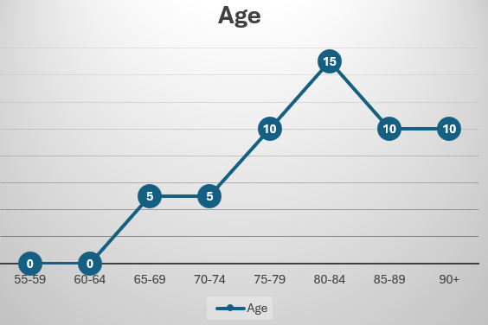

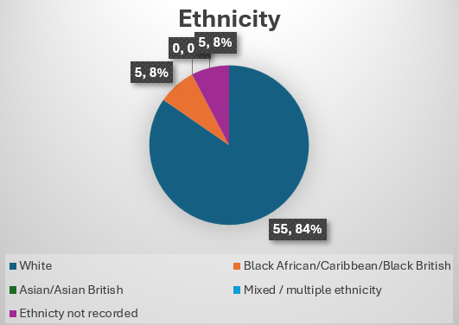
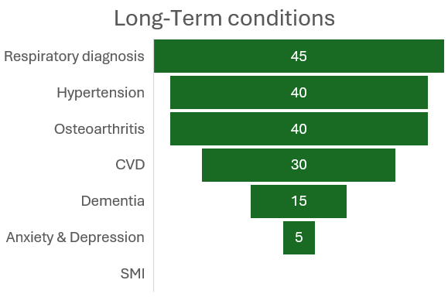
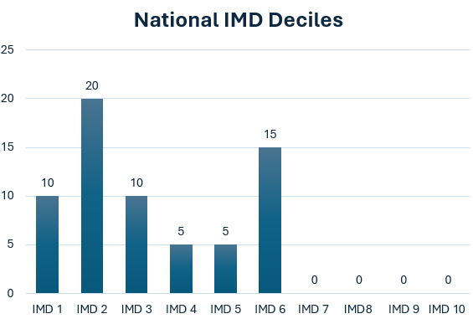
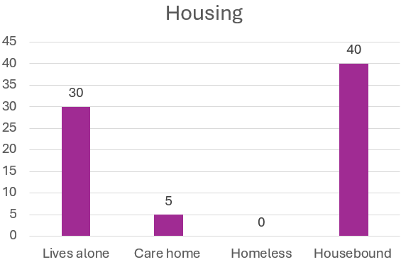
Bestwood & Sherwood PCN:
INT Cohort Data Pack November 2025
Cohort identification measures
Additional criteria applied
 | Segment one | Patients registered as End of Life or Organ Failure.
 | Segment two | Patients registered with Frailty or Dementia (excluding EoL)
 | Segment three | Patients with three or more long-term conditions
 | Three or more GP appointments within the last three months
 | All emergency admissions within the last twelve months
 | Not permanent care home resident
 | CityCare criteria: Community Matron caseload Community nursing caseload Community Rehab & Falls caseload
Leveraging elements of the Washwood methodology, data analysts have utilised E-Healthscope to identify patient cohorts aged 55+ with the greatest impact on healthcare services.
Population Overview
65 people meet the cohort identification criteria in Bestwood & Sherwood PCN
 | TOP 5 REASONS: Emergency admissions
1 | Falls (10 patients = 15%)
2 | Dyspnea (10 patients = 15%)
3 | Clouded consciousness (10 patients = 15%)
4 | Asthenia (5 patients = 7.5%)
5 | Syncope (5 patients = 7.5%)
90
45
50
46% of patients live alone
61% are housebound
8% in care homes

