Slide 1
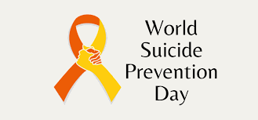
Bassetlaw Suicide Prevention & Mental Health Awareness Month
World Suicide Prevention Day is observed on September 10 each year to raise awareness that suicide is a major preventable cause of premature death and promote worldwide action to prevent suicides.
World Mental Health Day is observed on the 10th October each year to raise awareness of mental health issues, promote worldwide action to prevent mental ill-health and provide information and support for people experiencing mental ill health.
Mental health problems exist in our lives, families, workplaces and communities, impacting everyone. We all need to do as much as possible to prevent suicide and mental ill-health – as individuals and as a society.
The action agreed by Bassetlaw partners is to launch the first month long Suicide Prevention and Mental Health Awareness Campaign to run between September and October.
We encourage you to join us in taking simple and effective action to support our Bassetlaw communities.
Notes:
Good afternoon and Welcome, apologies for not being able to be with you in person- disappointed covid- Before we start just wanted to make you aware that presentations and slides being shared today will be distributed following this event along with resources and helplines focused on SP.
Suicide is everybody's business- as we have outlined here- really encouraging to see the range of partners that have taken time out to join us today
Death by suicide is a shocking event, with far-reaching and long-lasting consequences for loved ones, our communities, front-line professionals and wider society

Slide 2
SUICIDE PREVENTION & MENTAL HEALTH AWARENESS MONTH
#WSPD2022 #WMHD #BetterInBassetlaw #itsoknottobeok #itsoktotalkaboutsuicide
Share and like posts on social media. Copy to make your own using the #s.
Look out for news on radio interviews and podcasts.
Arrange ‘Wear Yellow and Green to Work Days’
Take a picture
email us here
Complete training
Make a Pledge
on our Suicide Prevention Alliance
Pledge Wall and let us know how you are supporting the campaign.
Raise awareness by displaying the posters provided and using the MS Teams background and email signature footers.

Slide 3
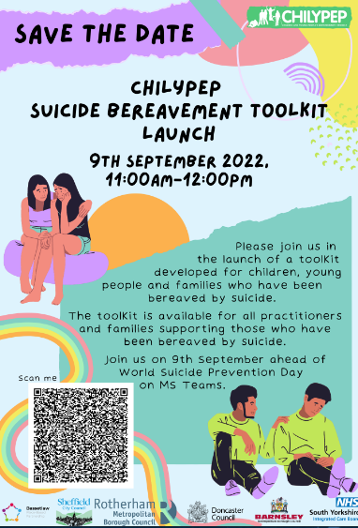
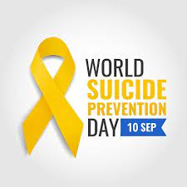
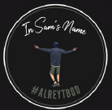
September 2022
Bassetlaw Suicide Prevention & Mental Health Awareness Month
Mon | Tues | Wed | Thurs | Fri | Sat
Bassetlaw’s 1st Suicide Prevention and Mental Health Awareness Month-Long Campaign is launched |  |  |  | 09 | 10
12 | 13 | 14 | 15 | 16
19 | 20 | 21 | 22 | 23 Harworth & Bircotes Pride event on 24th
26 | 27 | 28 | 29 | 30
Show your support on social media and join in sharing images of
lit candles at 8pm
We are asking partners to support this campaign by sharing consistent information and messages on a range of local and national support services to collaboratively raise awareness.
The services have been outlined on this calendar. A daily plan of information and logos to share will be sent each week for you to copy and paste into social media platforms using the #s below.
#WSPD2022 #WMHD #BetterInBassetlaw #itsoknottobeok #itsoktotalkaboutsuicide

Slide 4
October 2022
Bassetlaw Suicide Prevention & Mental Health Awareness Month
Mon | Tues | Wed | Thurs | Fri
03 | 04 | 05 Mental Health Crisis Helpline | 06 | 07 Support for the Armed Forces Community
10
The theme of 2022's World Mental Health Day, set by the World Federation for Mental Health, is 'Make mental health and wellbeing for all a global priority’.
To mark the end of our month-long campaign we will:
Share a video summary of all Bassetlaw Suicide Prevention and Mental Health services.
Obtain feedback to learn from our first Suicide Prevention and Mental Health Awareness Month with the aim of increasing our impact for Bassetlaw people.
Share pictures, stories, feedback and highlights on the campaign from partners - so please do keep us posted with any events!
#WSPD2022 #WMHD #BetterInBassetlaw #itsoknottobeok #itsoktotalkaboutsuicide

Slide 5
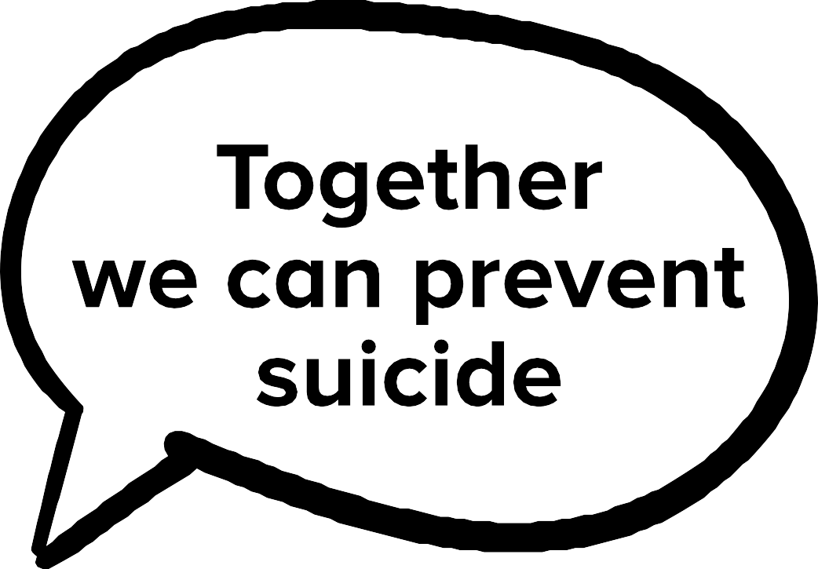
Suicide is everybody's business
Between 6,000 and 7,000 people die by suicide each year in the UK.
(National Suicide Prevention Alliance)
One person dies by suicide every 90 minutes.
Anybody can feel suicidal. But we can all help save a life.
Suicide is preventable.
By starting a conversation, we can all help stop suicide.
By removing the stigma that surrounds suicide, we can make it an everyday conversation. Together we can make it easier for everyone to talk about how they’re feeling.
Openly. Without judgement. Without shame.
So that no one has to struggle on their own.
#WSPD2022 #WMHD #BetterInBassetlaw #itsoknottobeok #itsoktotalkaboutsuicide
Notes:
Good afternoon and Welcome, apologies for not being able to be with you in person- disappointed covid- Before we start just wanted to make you aware that presentations and slides being shared today will be distributed following this event along with resources and helplines focused on SP.
Suicide is everybody's business- as we have outlined here- really encouraging to see the range of partners that have taken time out to join us today
Death by suicide is a shocking event, with far-reaching and long-lasting consequences for loved ones, our communities, front-line professionals and wider society

Slide 6
Useful Information and
Resources World Suicide Prevention Day
WSPD – IASP International Association for Suicide Prevention: general suicide prevention information as well as World Suicide Prevention Day resources (comms banners, activity ideas, facts and figures)
World Suicide Prevention Day | Campaigns | Samaritans
World Suicide Prevention Day - Mental Health UK (mentalhealth-uk.org)
Suicide awareness | Nottinghamshire County Council
Safe to talk about suicide leaflet (nottinghamshire.gov.uk)
Joint Strategic Needs Assessment: Suicide prevention (2016) - Nottinghamshire Insight (nottinghamcity.gov.uk)
The importance of language and suicide - Emma Nielsen – Mind your ‘C’s and ‘S’s: The Language of Self-harm and Suicide (and why it matters) | IMH Blog (Nottingham) (wordpress.com)
HOPE AND INSPIRATION: A conversation about suicide Book here.
#WSPD2022 #WMHD #BetterInBassetlaw #itsoknottobeok #itsoktotalkaboutsuicide
Notes:
Good afternoon and Welcome, apologies for not being able to be with you in person- disappointed covid- Before we start just wanted to make you aware that presentations and slides being shared today will be distributed following this event along with resources and helplines focused on SP.
Suicide is everybody's business- as we have outlined here- really encouraging to see the range of partners that have taken time out to join us today
Death by suicide is a shocking event, with far-reaching and long-lasting consequences for loved ones, our communities, front-line professionals and wider society

Slide 7
Useful Information and
Resources World Mental Health Day
Understanding self-harm Understanding Self Harm - Harmless
nottmnottsspguidanceflstaffvolunteerspublic.pdf (nottinghamshire.gov.uk)
World Health Organisation (WHO)
World Mental Health Day (who.int)
Mental Health Foundation
World Mental Health Day | Mental Health Foundation
United Nations
World Mental Health Day | United Nations
‘It’s Good to Talk’ project It’s Good to Talk (animation) – Young people sharing their experiences of mental ill health and how they found the resilience to manage this: https://youtu.be/BhrGkFBtcIo
It’s Good to Care (animation) – A harm minimisation booklet offering tools on how to manage and care for self-harm behaviours: https://youtu.be/wChwcM5IUtQ
Cost of living toolkit 2022: Communicating Help for Households and Cost of Living Payments - Understanding Universal Credit
#WSPD2022 #WMHD #BetterInBassetlaw #itsoknottobeok #itsoktotalkaboutsuicide
Notes:
Good afternoon and Welcome, apologies for not being able to be with you in person- disappointed covid- Before we start just wanted to make you aware that presentations and slides being shared today will be distributed following this event along with resources and helplines focused on SP.
Suicide is everybody's business- as we have outlined here- really encouraging to see the range of partners that have taken time out to join us today
Death by suicide is a shocking event, with far-reaching and long-lasting consequences for loved ones, our communities, front-line professionals and wider society

Slide 8
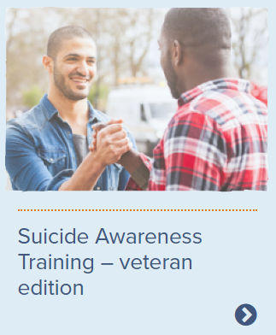
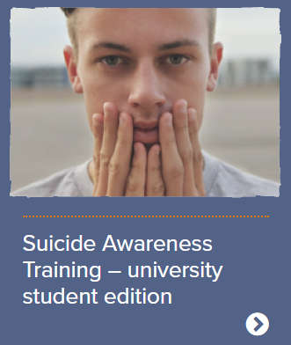
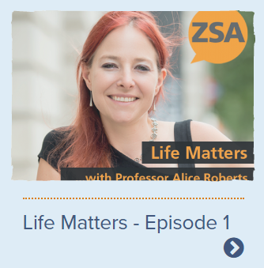
More useful Information, links to
resources and videos to share during the month
Anti-harm web browser tool
Watch explainer video
The Last Photo - Campaign Against Living Miserably (CALM)
THE WORDS: HOW TO START A CONVERSATION
Click here
Remember to Click here & Make a Pledge
on our Bassetlaw Suicide Prevention Alliance
Pledge Wall
DOWNLOAD
Bassetlaw Adult Mental Health Support - Community Providers poster – A3
Photos of Hope
Virtual
Art Exhibitions in
Manchester UK
#WSPD2022 #WMHD #BetterInBassetlaw #itsoknottobeok #itsoktotalkaboutsuicide
Notes:
Good afternoon and Welcome, apologies for not being able to be with you in person- disappointed covid- Before we start just wanted to make you aware that presentations and slides being shared today will be distributed following this event along with resources and helplines focused on SP.
Suicide is everybody's business- as we have outlined here- really encouraging to see the range of partners that have taken time out to join us today
Death by suicide is a shocking event, with far-reaching and long-lasting consequences for loved ones, our communities, front-line professionals and wider society

Slide 9
Support Services
Suicide and mental ill health can be a difficult topic.
Please keep yourself safe and seek support if you need it. You can get support from the following organisations.
Nottinghamshire Crisis Line (24/7) 0808 196 3779 Help in a crisis (nottinghamshirehealthcare.nhs.uk)
Samaritans (24/7) 116 123 Samaritans | Every life lost to suicide is a tragedy | Here to listen
Stay Alive app www.stayalive.app
SHOUT – text SHOUT to 85258 (24/7)
CALM, for men: 0800 585858 or webchat (5pm-midnight, 365 days per year)
PAPYRUS Hopeline: 0800 068 4141 (9am-midnight) for children and young people under the age of 35
#WSPD2022 #WMHD #BetterInBassetlaw #itsoknottobeok #itsoktotalkaboutsuicide
Notes:
Good afternoon and Welcome, apologies for not being able to be with you in person- disappointed covid- Before we start just wanted to make you aware that presentations and slides being shared today will be distributed following this event along with resources and helplines focused on SP.
Suicide is everybody's business- as we have outlined here- really encouraging to see the range of partners that have taken time out to join us today
Death by suicide is a shocking event, with far-reaching and long-lasting consequences for loved ones, our communities, front-line professionals and wider society

Slide 10
Want to know more about how you can be involved to support suicide prevention and mental ill health across Bassetlaw?
We encourage input from a range of colleagues across Bassetlaw Place within the NEW Bassetlaw Suicide Prevention Alliance working group to support our work focused on preventing suicides, or within our existing Adults and Children and Young People’s Mental Health Alliances.
Please contact Mel Fox mfox3@nhs.net to discuss your contributions to the Bassetlaw Suicide Prevention Alliance working group or Mental Health Alliances.
Bassetlaw Mental Health, Suicide Prevention and Health Inequalities Lead
Helen Azar: helen.azar@nhs.net
#WSPD2022 #WMHD #BetterInBassetlaw #itsoknottobeok #itsoktotalkaboutsuicide
Notes:
Good afternoon and Welcome, apologies for not being able to be with you in person- disappointed covid- Before we start just wanted to make you aware that presentations and slides being shared today will be distributed following this event along with resources and helplines focused on SP.
Suicide is everybody's business- as we have outlined here- really encouraging to see the range of partners that have taken time out to join us today
Death by suicide is a shocking event, with far-reaching and long-lasting consequences for loved ones, our communities, front-line professionals and wider society

