Slide 1
Transient Families 0-19 Team
Reducing Health Inequalities

Slide 2
Who are the TFT?
The Transient Families Team are a small specialist team of 7 clinicians offering the Healthy Child Programme (HCP) to...
Families and children seeking asylum
Unaccompanied Asylum-Seeking Children (UASC)
Irish Travellers

Slide 3
Why a Specialist Team?
Many of these children and families need more input to close the gap on avoidable health inequalities!

Slide 4
Irish Travellers
Experience discrimination
Literacy Levels low
Majority do not access education beyond primary school
Heightened Anxiety
Poor life expectancy
Increases rates of suicide
Low trust in professionals
To address the above
We offer longer appointment times to build trust
We visit the site weekly
We act as an advocate and support Irish travellers to access healthcare and are often the first point of access for healthcare

Slide 5
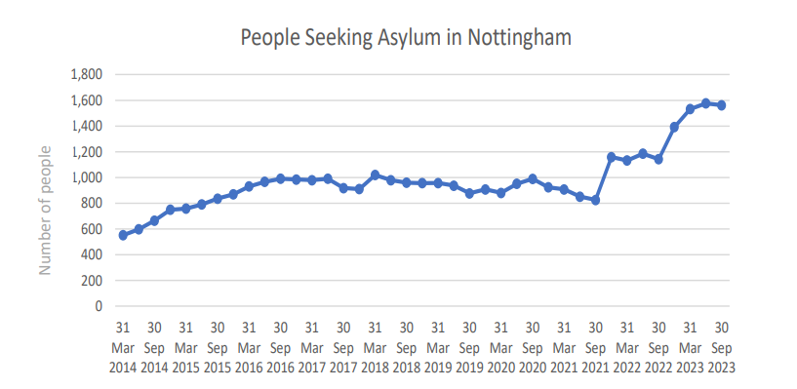
People Seeking Asylum
Adults and children in Nottingham
Office of National Statistics (2024)

Slide 6
TFT Caseload Sizes
Data obtained from CityCare clinical information systems provides some rationale as to why there were long waiting times for transfer in appointments. This is reflective of the JSNA. There has been an obvious increase year on year for families seeking asylum in Nottingham City. The recent JSNA (2024) also highlights a steep increase adults and children seeking asylum in Nottingham City.

Slide 7
Common Health Needs
seen in those seeking Asylum
POVERTY
Poor Nutrition
Lack of Basics such as Cot, Pushchair, School Uniform, Toys, formula milk, nappies and clothes
Unable To buy medication
ISOLATION
No family/friends
Language barrier
Cultural Barriers
IMMUNISATIONS
No records from home country
Struggle to book GP appointments
VITAMIN DEFICIENCES
Low Vitamin D
Anaemia
EMOTIONAL HEALTH OF THE CHILD
Fear
Challenging Behaviour
Nightmares
PARENTAL NEEDS
Poor Parental mental health
Poor physical health and a struggle to remedy these

Slide 8
Aisha’s Story
Aisha is a mother of a 3yr old girl, both are seeking asylum.
Aisha and her daughter have been significantly supported by the TFT
This is a short video where Aisha tells her story
Please find the link to the TFT video via the Frame.io website: https://f.io/a1GTRhJr

Slide 9
Unaccompanied Asylum Seeking Children (UASC)
The UK Home Office defines an UASC as
“a person under 18 years old, who is applying for asylum and is separated from both parents, and not in the care of a guardian”.
UASC are a child in care (CIC) and under care of Local Authority. There are currently 98 on TFT caseload.
Approximately 90% are aged 16 years and older.
Accommodation offered: Foster Homes, Residential Children’s Home, Semi-independent housing and supported housing
Many have suffered significant trauma- Life threatening journeys, separation and loss, abuse, subjected to war and torture
RISKS FACED: Child Exploitation – Sexual and Criminal, going missing, risk of abuse, poor education outcomes, poor physical and mental health
They require: Educational /School Placements, Emotional & Mental Health Needs, Advice on Access to their Rights.

Slide 10
Barriers/What’s difficult?
Trust towards professionals
Communication / Languages
Lack of provision for children and families
Information sharing between professionals
Appointments take 50% longer
Political climate
Lack of staff training
Emotionally upsetting for staff

Slide 11
Partnership Working
Local Authority – Nottingham City
Midwives
Serco
Migrant Help
Nottingham Refugee Forum
Al-Hurraya – culturally specific for mental health
Nottingham and Nottinghamshire Refugee Forum
GPs
A range of charities

Slide 12
Partnership feedback
“These families are amongst the most vulnerable and deprived however the team are always respectful and understanding of the different values and take an holistic approach in considering cultural, family and societal needs”
“The team have a genuine interest in all their clients, whilst retaining a focus on needs of the child”
“The team ensure that all children are safeguarded and protected, identifying those at risk and support local safeguarding arrangements, ensuring the voice of the child is considered”
“The team always ensure that the needs of the service users are being met by all, challenging wherever necessary to get the best outcome for the child and family”
“The team are incredibly adaptable in their support and have a can-do attitude on this work and across the board, nothing daunts them. This is a challenging role and they work with limited resources but the team never give up on the tasks they are faced with”

Slide 13
What have we achieved in the last 2 years?
We have supported many children and their families and completed many escalations and referrals for individual children to ensure health and social care needs are met
Opened a drop-in Stay & Play Clinic, weekly at Tower Block accommodation - well attended by People Seeking Asylum
Opened a monthly clinic at the hotel housing families seeking asylum
The TFT highlighted a gap in information sharing between professionals and through working with the Local Authority we now have a safeguarding meeting every month to discuss any concerns
We have had discussions about the Travellers with midwifery service and highlighted that they would benefit from access to a specialist midwife. This is now being considered…
We continue to raise awareness about the injustice of not using interpreters at the birth registration in Nottingham City
We have campaigned to stop babies under 1 from being placed in hotels without suitable safe sleeping arrangements.

Slide 14
Future Plans for the TFT
We would like to take responsibility for offering the HCP to children in domestic abuse refuges, these children are most transient and are very vulnerable
Expand the team in staff numbers to ensure more timely appointments for 5-19 year old
Simplify the process to enable accessibility to all donations and seek support from the Nottingham Citycare Community Charity
Continue to seek any training for staff and psychological support

Slide 15
References
Friends, Families & Traveller Charity Group (2021) www.Gypsy-Traveller.org
Home Office. (2023). Asylum and resettlement datasets. Retrieved from Gov.uk: https://www.gov.uk/government/statistical-data-sets/asylum-andresettlement-datas
Human Rights Watch, 2001 www.hrw.org
Nottingham City Council, JSNA People Seeking Asylum, Refugees and People Refused Asylum (2024)
RMcManus, M McGovern, K Tong, J.O;Brien, A Doherty,(2023) Experiences of self-harm and suicidality in a community sample of Irish Travellers, European Psychiatry, Supple:1; S1115
Parry et al (2007) ‘Health status of Gypsies and Travellers in England’. J Epidemiol Community Health. 2007 Mar; 61(3): 198–204
The Equality & Human Rights Commission, (2018 & 2019)

