Slide 1
Slavery Exploitation Team
Jane Paling

Slide 2
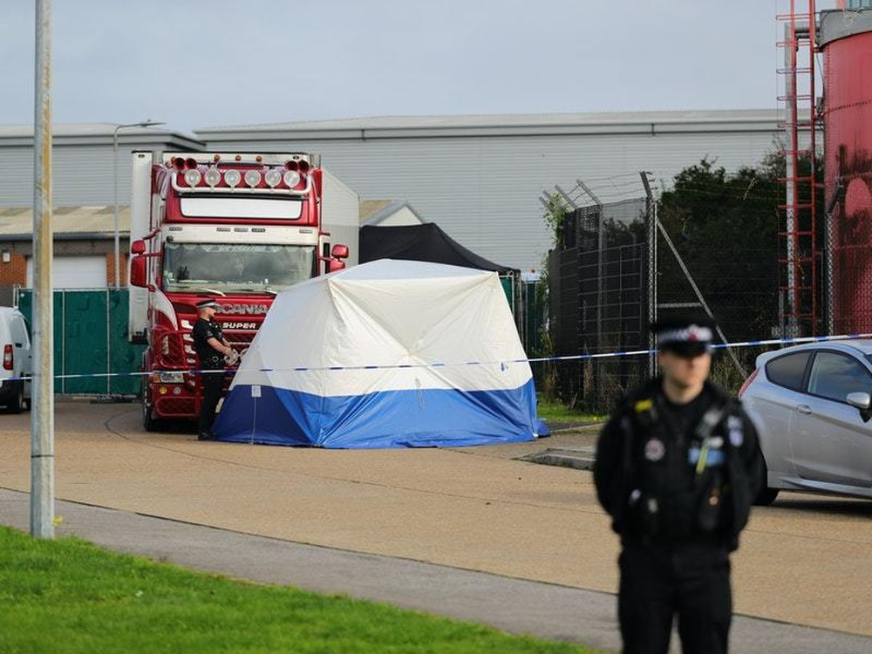
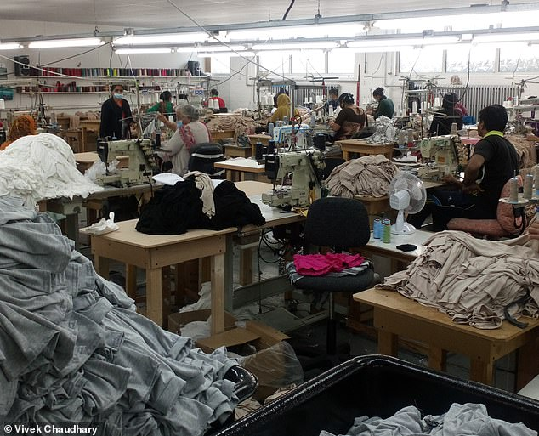
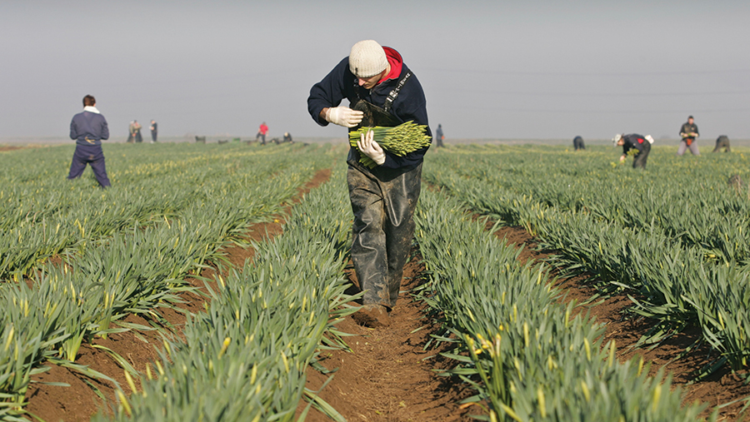
Identifying the need - Perceptions and Reality of Slavery and Exploitation

Slide 3
Service Offer
Journey of a referral
SERAC – creative discussion, solution focus
Thresholds
Training
Single Point of Contact
Multi agency visits
Risk Management
Strategic Role

Slide 4
Types of Exploitation 2024

Slide 5
Vulnerabilities 2024

Slide 6
Consent
Consent is not required for referrals to the SET or SERAC. If someone is currently being exploited of held in slavery, there are likely to be elements of coercion and control. Should consent be sought to refer, the potential victim may disclose this to their exploiter, placing them at risk of harm or trafficking.
The legal basis under which such information can be shared for the purposes of safeguarding is covered mainly through:
Prevention and detection of crime (s.115 Crime and Disorder Act 1998)
To protect victim or others from serious harm or matter of life or death (GDPR art.6 & 9)
For a public task (vital interests - usually bringing perpetrators to justice)
Right to be free from torture or inhuman or degrading treatment (Human Rights Act, Articles 2 & 3)
Prevention of Abuse and Neglect (The Care Act 2014)
There may be other legal basis on specifics of individual cases (FGM, forced marriage, child protection etc).

Slide 7
Case Studies
Case 1 – ‘Low Level’ Financial Exploitation
Case 2 – Criminal Exploitation & Cuckooing case of male with hereditary brain condition
Case 3 – Domestic Servitude (ASC assessment involvement)

Slide 8
Contact Details
MSVP@nottinghamcity.gov.uk

