Slide 1
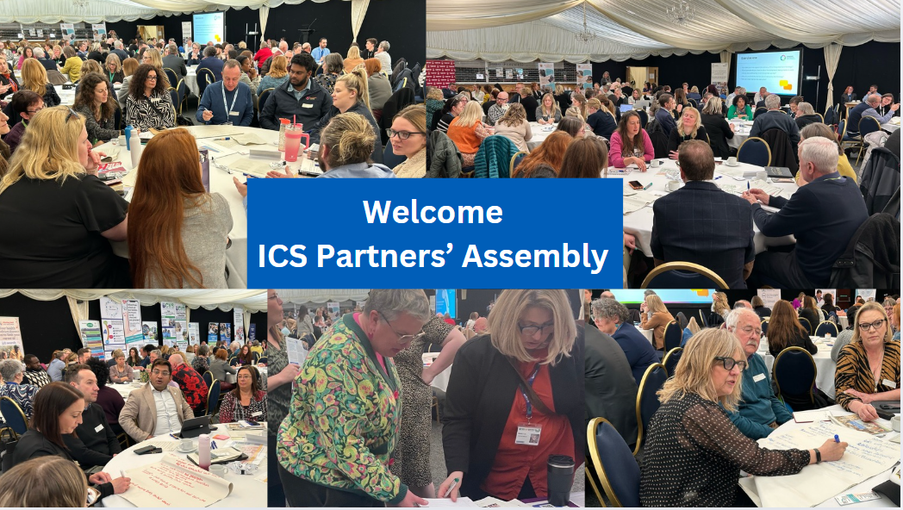
Wifi: icca-guest
#TogetherWeAreNotts

Slide 2

Please take your seats
The event is about to begin
#TogetherWeAreNotts

Slide 3
Introduction
Alex Ball
Mobile phones on silent
Wifi code: icca-guest
Fire safety
British Sign Language interpreter
#TogetherWeAreNotts hashtag
Photographer
Facilitators on each table

Slide 4
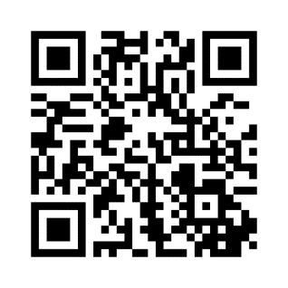
Mentimeter
www.mentimeter.com
menti.com - code is 8608 9850
#TogetherWeAreNotts

Slide 5


Slide 6
Running order
Alex Ball
9.30 – 10am: marketplace and networking
10.00 – 10.10am: welcome
10.10 – 10.20am: 10 year plan introduction
10.20 – 10.50am: presentations on three shifts
10.50 – 11.30am: exercise one
11.30 – 12.00pm: break / marketplace event
12.00 – 12.10pm: Integrated Care Strategy refresh
12.10 – 12.50pm: exercise two
12.50 – 1.00pm: close

Slide 7
Dr Kathy McLean
NHS 10 year plan
#TogetherWeAreNotts

Slide 8

What is this all about?
Information
Our NHS is facing challenges and needs to change to make sure health and care services are fit for the future.
But to fix health and care services, the Government needs to learn from your experiences and hear your ideas.
Your views, experiences and ideas will shape immediate steps and long-term changes in a new 10 Year Health Plan.

Slide 9
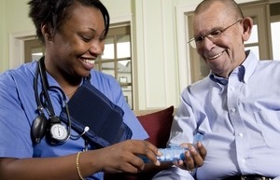

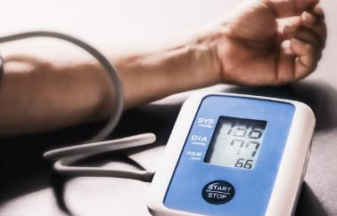
The 10 Year Health Plan will be built around 3 shifts:
Information
These changes will be the focus of our conversation today
Moving more care from hospitals to communities
Making better use of technology
Preventing sickness, not just treating it
Moving care from hospitals into homes, closer to the places people live and their community.
Using digital technology promises faster, higher-quality, more connected care.
Preventing rather than simply treating sickness will keep people healthier for longer.

Slide 10
SAIU Showcase:
How AI is aiding productivity
Simon Frampton – Head of Quality
Performance & Insights
Temitope Akingbala – ICB Principal Data Analyst

Slide 11
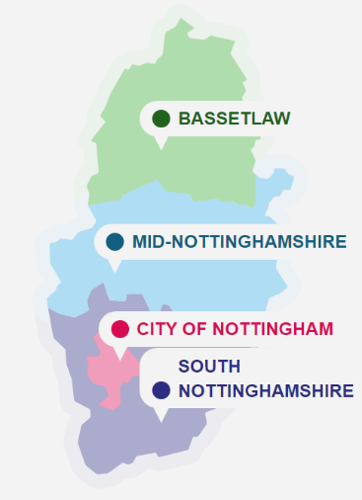
Who We Are
Nottingham and Nottinghamshire System Analytical Intelligence Unit (SAIU)
The System Analytics Intelligence Unit (SAIU) was launched on 4 July 2022. This followed the COVID pandemic, where as a system we identified the huge value and benefit of integrated working with our systems data/intelligence and analytical partners to better identify and support the health and care of our population.
We have professional analysts, covering our core system areas:
PHM/HI & Outcomes
Primary Care & Community Care
Urgent Emergency Care, Planned Care
Demand Capacity & Planning
Workforce
Mental Health
Quality/Maternity
Children and young People
Performance

Slide 12
What is AI & Automation?
Most AI today is classified as ‘Narrow’ or ‘Weak AI’, that is to say it is designed to perform specific, narrow task (e.g., facial recognition, internet searches, or driving a car). Most current AI systems, including those that can play complex games like chess and go, fall under this category. They operate within a limited, predefined range or set of contexts.
Automation on the other hand, involves using technology to perform tasks automatically, following predefined rules without the ability to learn or adapt beyond their programming.
Example AI Applications within the NHS & SAIU
  Predictive Analytics (Machine Learning):
    Forecasting patient admissions or resource needs.
    Identifying at-risk patients for early interventions.
  Natural Language Processing:
    Developing chatbots to assist patients with appointment scheduling.
    Automating the analysis of patient feedback.
  Expert Systems:
    Clinical decision support tools to assist healthcare professionals.

Slide 13







Why we need AI & Automation
Creating efficiencies in a highly complicated system is key to enabling high quality analytics
Secondary care providers
capacity & flow
aggregate metrics (live)
Azure
Transfer of care hub patient trackers (NHS numbers)
Commissioning data sets
SQL database
(pseudonymised)
Dashboard view (aggregate)
Local data sets e.g. social care, public health
Sitreps (aggregate)
API
GP data
Clinician workflows and single register
(patient identifiable)
PHM tools (aggregate)
GRPCC
SQL database
(NHS numbers)

Slide 14
Future Ambitions
Enhancing User Engagement and Overall Experience of System Users with Our Analytical Products
Automated solutions underway to provide user-friendly search functionality to mimic a Full ‘fuzzy’ / Google like search experience for our dashboards
Currently developing automated and dynamic risk assessments and cloud-based reporting to provide real-time insights to aid operational decisions
Overlay AI on the SCC dashboard to help predict future events
Conversational AI for Dashboard/Report Exploration and Narrative Summarization to breakdown complex concepts into clear and simple natural language interpretations.
Cloud-based Automations, AI-driven Insights and Alerts
Gen AI supported Chatbots for managing end user FAQs on platforms like eHealthscope

Slide 15
Future Ambitions
We are also committed to making our analysts more efficient by harnessing AI & Automation to transform the development of analytical solutions to system problems.
Several implementations are scoped for the near future;
Advanced ML Techniques (logistic regression, process mining, random forests etc.) and the use of modern Forecasting tools e.g., Prophet
Gen. AI for Analyst Project Documentations & Training Materials (e.g., Ai training videos)
Automation of routine analytical processes like data cleaning or dashboard updates and refreshes using scripted process automations cheaper than RPA.
AI Agents for Web Scraping tasks pulling routine data from external sources

Slide 16
Thank you
Any questions?

Slide 17




Community: Early Intervention Speech and Language team

Slide 18
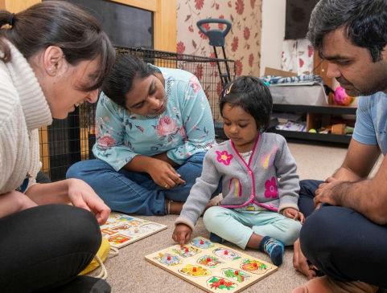

Community: Early Intervention Speech and Language team
Home visiting service
Speech and Language support
Tailored to each child
Experienced Staff

Slide 19
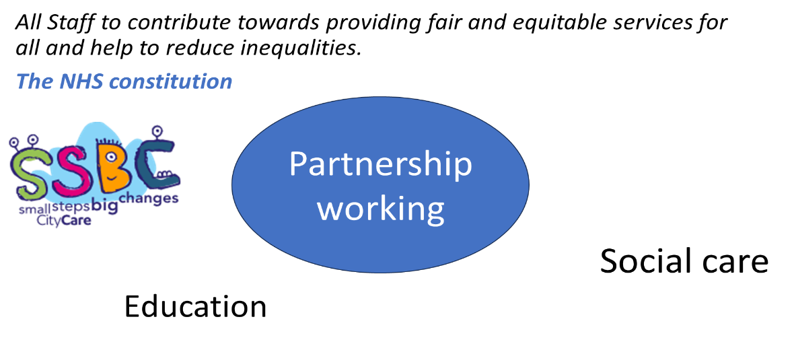
Community: Early Intervention Speech and Language team
community
Health

Slide 20
Thank you

Slide 21
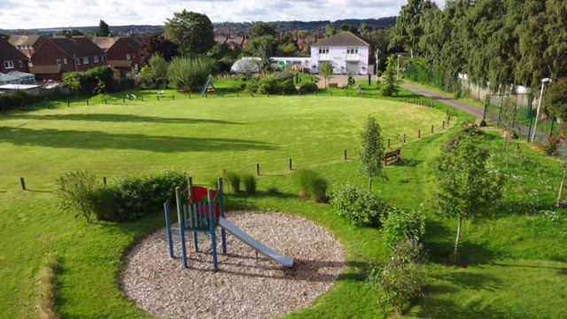
Prevention: Men at the Edge
OASIS
COMMUNITY
CENTRE
& GARDENS
Worksop
Notes:
21

Slide 22

Prevention: Men at the EDGE
The EDGE is a project managed by OASIS Community Centre in Worksop. Oasis runs over 35 projects aiming to improve
life, health and wellbeing for people of all ages.
MEN AT THE EDGE is a project which is specially designed to
support men at their point of need or crisis.
Notes:
22

Slide 23
Prevention: Men in crisis!
High levels of suicide in the area almost entirely of men between the ages of 18 and 55 years.
Challenges accessing care, counselling, safe spaces, therapy or support for men of any age in the community.
Men are often silent about issue and rarely seek out people to talk to, advice, diagnosis, help or comfort until it is often too late.
Stigma attached to men with problems or addictions
Notes:
23

Slide 24
Prevention: Male Problems
Men at the Edge of what?
Unemployment, Poverty, Mental Health, Breakdown,
Victims of Abuse, Physical Illness, Disability, Addiction, Bereavement, Sucidal Thoughts, Dementia, Emotional Turmoil, Hopelessness, Fear, Anxiety, Depression.
Great Things, New Job, Volunteering, Becoming a Dad, New Relationship, New Friends, New Start etc!
Notes:
24

Slide 25
Prevention: Simple Solution
Men at the Edge drop in days in a safe place!
Immediate Help with someone to Listen and Care.
Practical Help, Support and Understanding.
Therapeutic Health and Wellbeing interventions.
Considering the whole person, body, mind and spirit.
Reducing isolation through community contact.
Working in partnership with other support organisations.
Notes:
25

Slide 26
Prevention: Men at the EDGE
'A Place where noone is turned away!'
'A Heart for the Community in the Heart of the Community!'
'Organisations working together to make a difference!'
'Transforming the Community one life at a time!'
Notes:
26

Slide 27
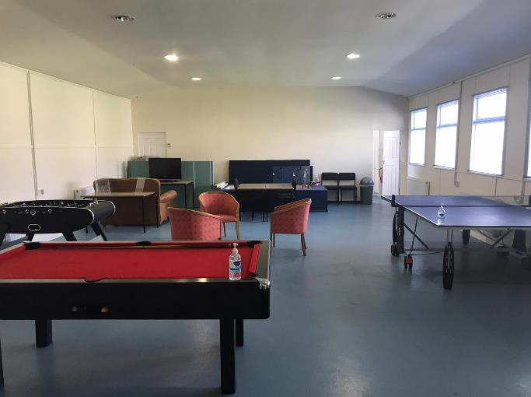
THE EDGE
Worksop
Notes:
27

Slide 28
Exercise one
10 year plan
#TogetherWeAreNotts

Slide 29
10 year plan discussion
Digital
When you think about how we could use technology in the wider health and care system, what difference (good or bad) would this make to you?
What technologies do you think the wider system should prioritise: Why?

Slide 30
10 year plan discussion
Prevention
Preventing sickness, not just treating it - what difference (good or bad) would this make to you?
What three forms of prevention should be prioritised and why?

Slide 31
10 year plan discussion
Community
Moving more care from hospitals to communities – what difference (good or bad) would this make to you?
What three areas should be prioritised and why?

Slide 32
Exercise one feedback
#TogetherWeAreNotts

Slide 33
Mentimeter
www.mentimeter.com
menti.com - code is 8608 9850
#TogetherWeAreNotts

Slide 34
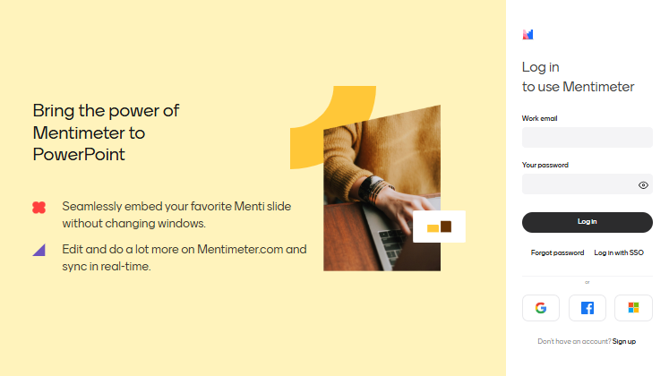

Slide 35
Break / marketplace
#TogetherWeAreNotts

Slide 36
Welcome back
Please return by 12pm
#TogetherWeAreNotts

Slide 37
Dr Kathy McLean
Integrated Care Strategy
#TogetherWeAreNotts

Slide 38
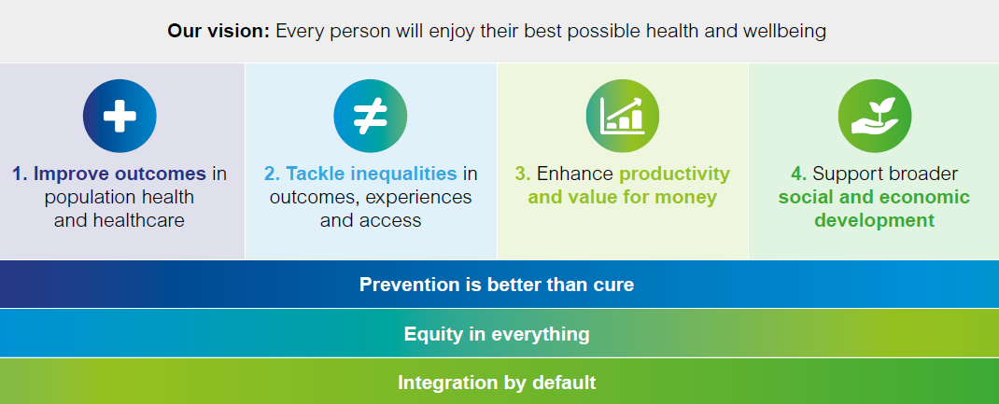
Our Aims and Ambitions
Aligning to the aims for ICSs as a strategic framework, and focusing on three guiding principles for the system

Slide 39
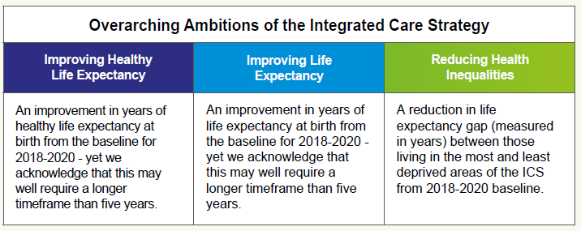
Our collective system focus
Healthy Life Expectancy | Life Expectancy | Health Inequalities
Baseline (2018-2020): Females: 57.1 years Nottingham 60.0 Nottinghamshire Males: 57.4 years Nottingham 62.4 years Nottinghamshire | Baseline (2018 - 2020): Females: 81.0 years Nottingham 82.6 years Nottinghamshire Males: 76.4 years Nottingham 79.5 years Nottinghamshire | Baseline (2018-20): Females: 7.6 years Nottingham 7.7 years Nottinghamshire Males: 8.4 years Nottingham 9.3 years Nottinghamshire
Office of National Statistics (ONS) expect to publish data for 2019-21 and 2020-22 by end of 2024 calendar year | Latest (2020 - 2022): Females: 80.5 years Nottingham 82.6 years Nottinghamshire Males: 75.8 years Nottingham 78.8 years Nottinghamshire | Data for 2018-2020 are the latest available
Source: Public Health Outcomes Framework | Source: Public Health Outcomes Framework / Office for Health Improvement and Disparities (OHID) Fingertips | Source: Public Health Outcomes Framework A local methodology is being developed using Patients registered with a GP Practice.

Slide 40
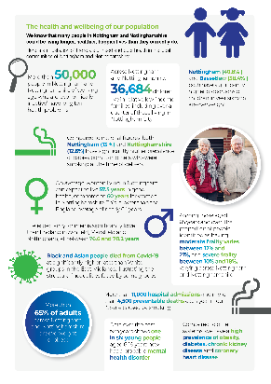
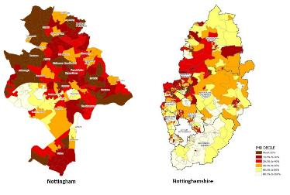
We recognise that the needs of our population are high and there are stark differences between areas…
People are dying earlier than they should be – Nottingham City, Ashfield and Mansfield have significantly higher rates of avoidable and preventable deaths than the England average (and double that in other areas of our ICS).
Inequalities are stark, with inequalities in health reflecting deprivation and social inequalities.
Preventable alcohol and CVD deaths are getting worse.
Our children are not as healthy as they should be, childhood obesity remains high.
The number of people accessing some screening programmes is lower than needed.

Slide 41



…and, the environment that we are working in has changed
All public services are under pressure – facing rising demand and increased need for services, as well as meeting national and regulatory requirements.
Local people and organisations continue to face financial challenges.
Organisations are encountering increasing workforce costs.
Formation of the Combined East Midlands Authority bringing opportunity to our local area.
National and local political changes.

Slide 42
Exercise two
Integrated Care Strategy
#TogetherWeAreNotts

Slide 43
Exercise two
Does our current vision, principles and priorities for the system remain the most appropriate to meet the needs of our population?
How do we better align our individual organisational priorities to create added value at a system level?
What else needs to happen to maintain sustainability as integrated care system?

Slide 44
Exercise two feedback
#TogetherWeAreNotts

Slide 45
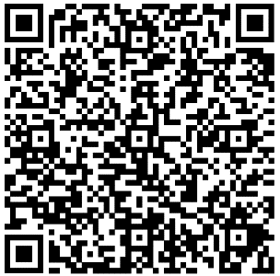
Closing comments
#TogetherWeAreNotts

