Slide 1

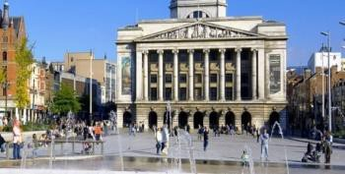


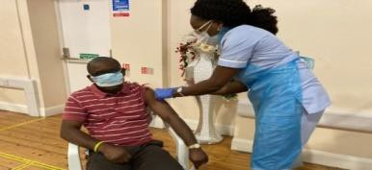

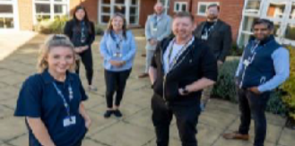
Nottingham and Nottinghamshire Integrated Care System (ICS)
Partnership Agreement
We, the collective leaders of Nottingham and Nottinghamshire ICS, have agreed to establish a ‘Partnership Agreement’ to demonstrate our commitment to work effectively together for the benefit of all our communities and residents.
Our priority is to support, care for and be compassionate to local people. The role of our ICS is to enable health and care professionals, local authority colleagues, those that work in the voluntary, community and social enterprise (VCSE) sector and in social care to collaborate. This means working across organisational boundaries to maximise the use of our energies and resources. It also means taking decisions as close to our population as possible and working together to listen to each other and implement joint plans.
We do not underestimate the challenges ahead as our ICS looks to implement our shared Integrated Care Strategy but through our Partnership Agreement we commit to work together with the shared purpose of:
“Every person enjoying their best possible health and wellbeing”
This will require us to think as widely as possible – considering all the factors which make a difference to health such as housing, education, employment and much more.
We have agreed three main principles and confirmed four aims within our Integrated Care Strategy that will guide our ways of working together:
Principles
Prevention is better than cure;
Equity in everything;
Integration by default.
These principles will be underpinned by the following core values:
  We will be open and honest with each other;
  We will be respectful in working together;
  We will be accountable, doing what we say we will do and following through on agreed actions;
  We will challenge each other if we fall short of upholding these principles and aims.
Finally, we will work with, and put the needs of, our population at the heart of the ICS: All system partners are committed to consistently listening to, and collectively acting on, the experience and aspirations of local people and communities.
Aims
Improve outcomes in population health and healthcare;
Tackle inequalities in outcomes, experiences and access;
Enhance productivity and value for money;
Support broader social and economic development.
#TogetherWeAreNotts

Slide 2

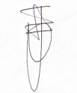

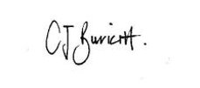



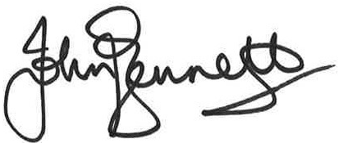

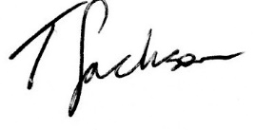

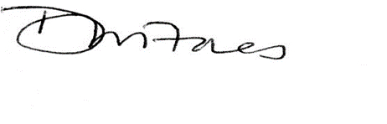
Nottingham and Nottinghamshire Integrated Care System (ICS)
Signatories
The following organisations and leaders are all equal peer signatories to the Partnership Agreement – they are listed here in alphabetical order to reflect that there is no hierarchy intended. All organisations that work within the ICS are welcome to sign the Agreement and can do so at www.healthandcarenotts.co.uk at any time. It should also be noted that many of the organisations below also deliver services for a wider population than Nottingham and Nottinghamshire.
Organisation | Name and job title | Signature
 | Helen Davis, Strategic Lead
 | Carol Burkitt, Chief Executive A Place To Call Our Own
 | Umar Ahmad, Clinical Director
 | John Bennett, Executive Director – Place
 | Teresa Jackson, Interim Chief Executive officer
 | Debra Fores, General Manager

Slide 3

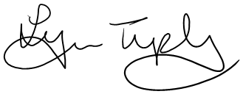

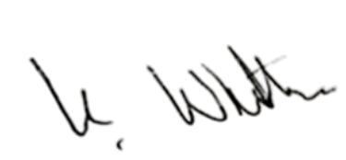





Nottingham and Nottinghamshire Integrated Care System (ICS)
Signatories
The following organisations and leaders are all equal peer signatories to the Partnership Agreement – they are listed here in alphabetical order to reflect that there is no hierarchy intended. All organisations that work within the ICS are welcome to sign the Agreement and can do so at www.healthandcarenotts.co.uk at any time. It should also be noted that many of the organisations below also deliver services for a wider population than Nottingham and Nottinghamshire.
Organisation | Name and job title | Signature
 | Lynn Tupling, Chief Executive
 | Karen Whitlam, Chief Executive
 | Andria Birch, Chief Executive
 | Councillor Lynne Schuller, Portfolio Holder for Health and Wellbeing
 | Robert Garland, Food Bank Manager Bassetlaw Food Bank
Robert Garland

Slide 4

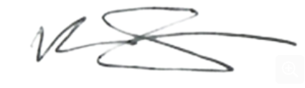





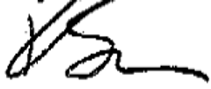

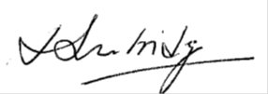
Nottingham and Nottinghamshire Integrated Care System (ICS)
Signatories
The following organisations and leaders are all equal peer signatories to the Partnership Agreement – they are listed here in alphabetical order to reflect that there is no hierarchy intended. All organisations that work within the ICS are welcome to sign the Agreement and can do so at www.healthandcarenotts.co.uk at any time. It should also be noted that many of the organisations below also deliver services for a wider population than Nottingham and Nottinghamshire.
Organisation | Name and job title | Signature
 | Richard Roberts, Chairman Bearded Fishermen (mental health charity)
 | Glyn Davies, Contracts Manager South Barnsley Premier Leisure
 | Ruth E Hyde OBE, Chief Executive
 | Georgia Crossland (young people’s charity)
 | Kate Baxter, Chief Executive
 | Louise Bainbridge, Chief Executive
Glyn Davies
G.Crossland

Slide 5





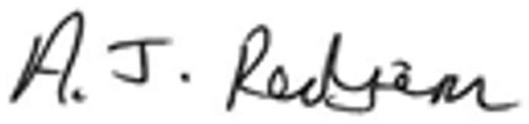


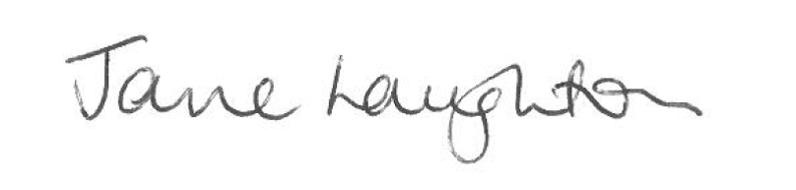
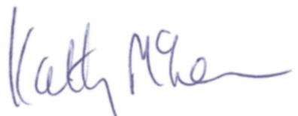
Nottingham and Nottinghamshire Integrated Care System (ICS)
Signatories
The following organisations and leaders are all equal peer signatories to the Partnership Agreement – they are listed here in alphabetical order to reflect that there is no hierarchy intended. All organisations that work within the ICS are welcome to sign the Agreement and can do so at www.healthandcarenotts.co.uk at any time. It should also be noted that many of the organisations below also deliver services for a wider population than Nottingham and Nottinghamshire.
Organisation | Name and job title | Signature
 | Richard Henderson, Chief Executive
 | Volt Sacco, Chief Executive, Partner Member of Integrated Care Partnership
 | Andrew Redfern, Chief Executive, Partner Member of Integrated Care Partnership
 | Jane Laughton, Chief Executive
 | Dr Kathy McLean, Chair of the Nottingham and Nottinghamshire Integrated Care Partnership

Slide 6



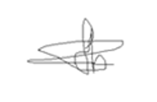

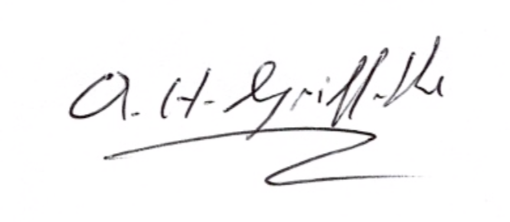



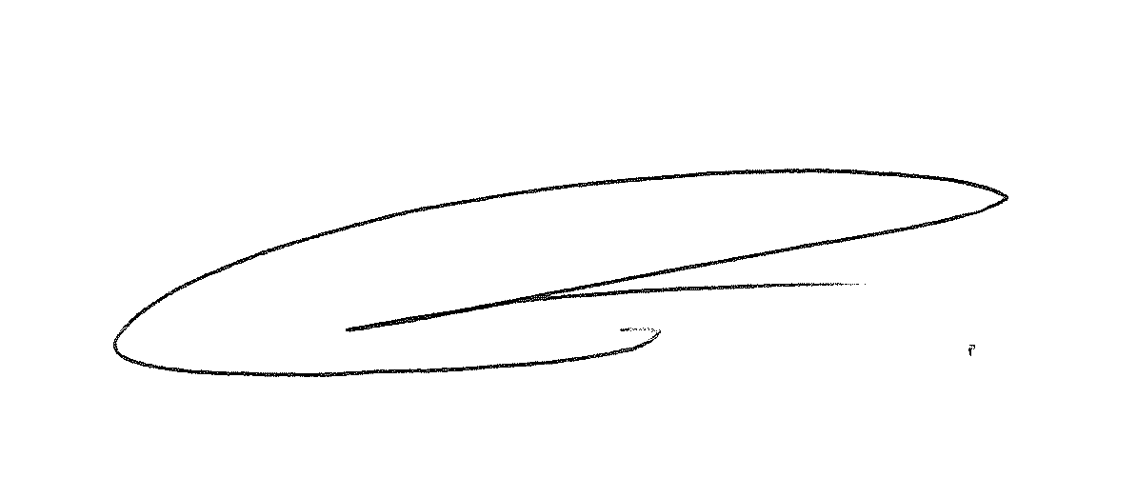


Nottingham and Nottinghamshire Integrated Care System (ICS)
Signatories
The following organisations and leaders are all equal peer signatories to the Partnership Agreement – they are listed here in alphabetical order to reflect that there is no hierarchy intended. All organisations that work within the ICS are welcome to sign the Agreement and can do so at www.healthandcarenotts.co.uk at any time. It should also be noted that many of the organisations below also deliver services for a wider population than Nottingham and Nottinghamshire.
Organisation | Name and job title | Signature
 | Dr Nanthakumar Vaithilingam, Clinical Director, Larwood and Bawtry PCN
 | Rob Holder, General Manager, North Nottinghamshire
 | Arwel Griffiths, Chief Executive
 | Richard Parker, Chief Executive
 | Ifti Majid, Chief Executive
 | Amanda Sullivan, Chief Executive

Slide 7

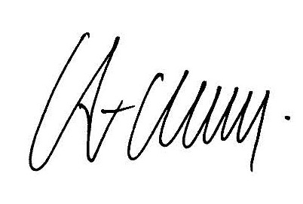



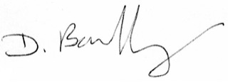


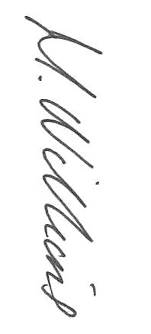

Nottingham and Nottinghamshire Integrated Care System (ICS)
Signatories
The following organisations and leaders are all equal peer signatories to the Partnership Agreement – they are listed here in alphabetical order to reflect that there is no hierarchy intended. All organisations that work within the ICS are welcome to sign the Agreement and can do so at www.healthandcarenotts.co.uk at any time. It should also be noted that many of the organisations below also deliver services for a wider population than Nottingham and Nottinghamshire.
Organisation | Name and job title | Signature
 | Anthony May, Chief Executive
 | Paul Robinson, Chief Executive
 | Dr. D. Bartholomeuz , Clinical Director
 | Mel Barrett, Chief Executive
 | Mel Barrett, Nottingham City Place Based Partnership
 | Melanie Williams, Corporate Director

Slide 8



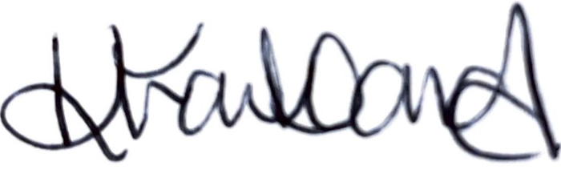






Nottingham and Nottinghamshire Integrated Care System (ICS)
Signatories
The following organisations and leaders are all equal peer signatories to the Partnership Agreement – they are listed here in alphabetical order to reflect that there is no hierarchy intended. All organisations that work within the ICS are welcome to sign the Agreement and can do so at www.healthandcarenotts.co.uk at any time. It should also be noted that many of the organisations below also deliver services for a wider population than Nottingham and Nottinghamshire.
Organisation | Name and job title | Signature
 | Professor Edward Peck, Vice-Chancellor
 | Karen Frankland, Managing Director
 | Dr Eric Kelly, Clinical Director
 | Anita Ollerenshaw, Farm Manager
 | Sarah Bray, Operations Manager

Slide 9

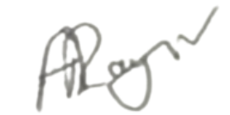

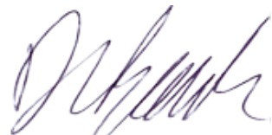



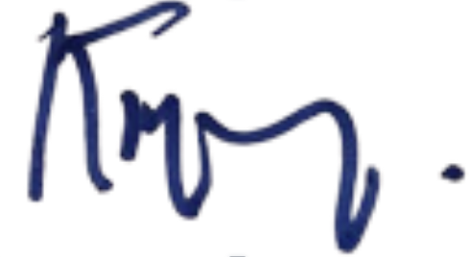
Nottingham and Nottinghamshire Integrated Care System (ICS)
Signatories
The following organisations and leaders are all equal peer signatories to the Partnership Agreement – they are listed here in alphabetical order to reflect that there is no hierarchy intended. All organisations that work within the ICS are welcome to sign the Agreement and can do so at www.healthandcarenotts.co.uk at any time. It should also be noted that many of the organisations below also deliver services for a wider population than Nottingham and Nottinghamshire.
Organisation | Name and job title | Signature
 | Alex Raynor, Director
 | Dave Banks, Director - Neighbourhoods and Deputy Chief Executive
 | Gurvinder Sahota, Clinical Director
 | Paddy Tipping, Non-Executive Director Nottinghamshire (Chair)

Slide 10

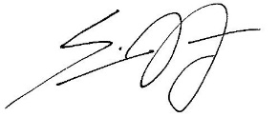

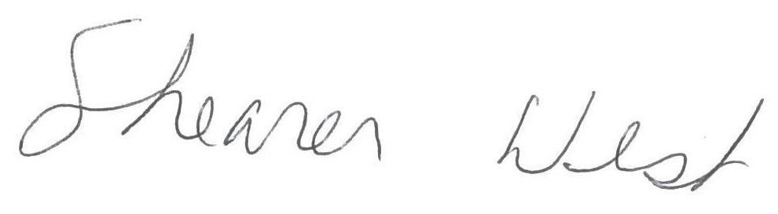


Nottingham and Nottinghamshire Integrated Care System (ICS)
Signatories
The following organisations and leaders are all equal peer signatories to the Partnership Agreement – they are listed here in alphabetical order to reflect that there is no hierarchy intended. All organisations that work within the ICS are welcome to sign the Agreement and can do so at www.healthandcarenotts.co.uk at any time. It should also be noted that many of the organisations below also deliver services for a wider population than Nottingham and Nottinghamshire.
Organisation | Name and job title | Signature
 | Simon Cartwright, Chief Officer
 | Shearer West, President and Vice Chancellor
 | Dr Rebecca Foljambe, Founder

