Slide 1

Our Integrated Care System
Working together for better health and care
#TogetherWeAreNotts

Slide 2
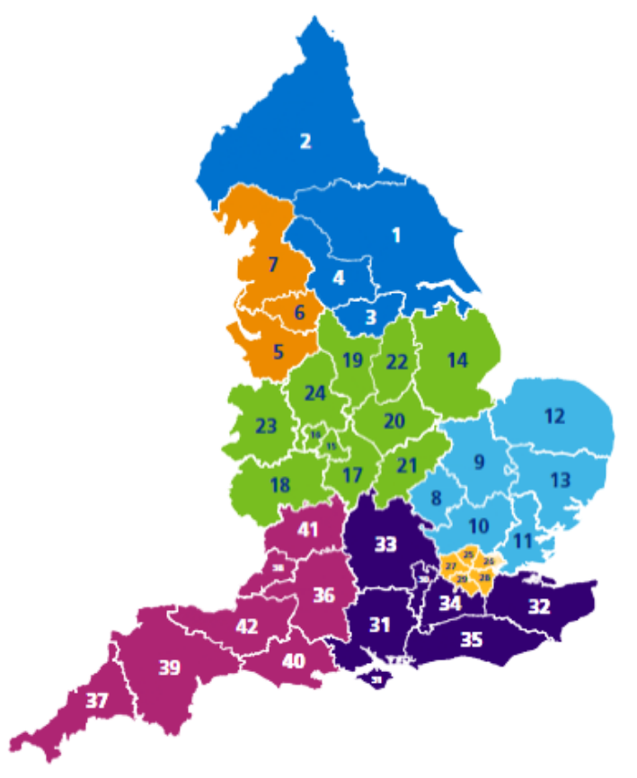
What is an ICS and why?
A changing landscape
There are 42 Integrated Care Systems (ICSs) across the country. They are partnerships of health and care organisations that come together to plan and deliver joined up services and to improve the health of people who live and work in their area.
They exist to achieve four aims:
Improve outcomes in population health and healthcare
Tackle inequalities in outcomes, experience and access
Enhance productivity and value for money
Help the NHS support broader social and economic development.

Slide 3
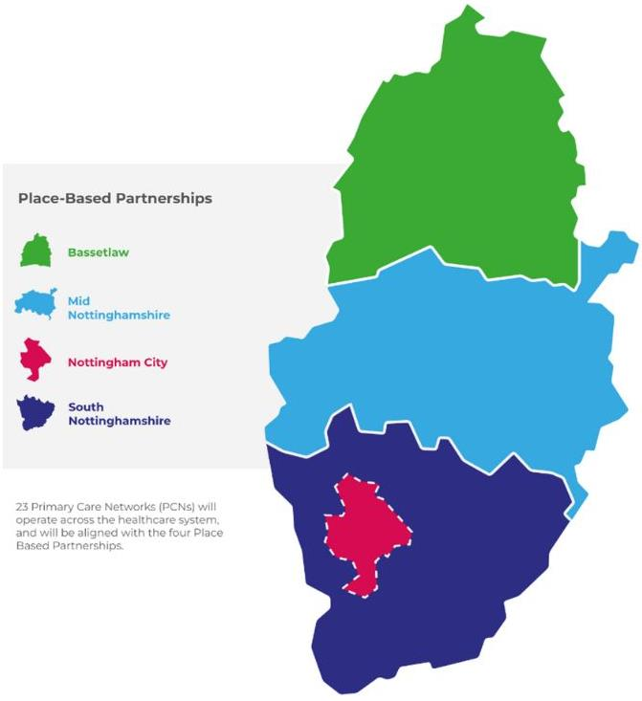
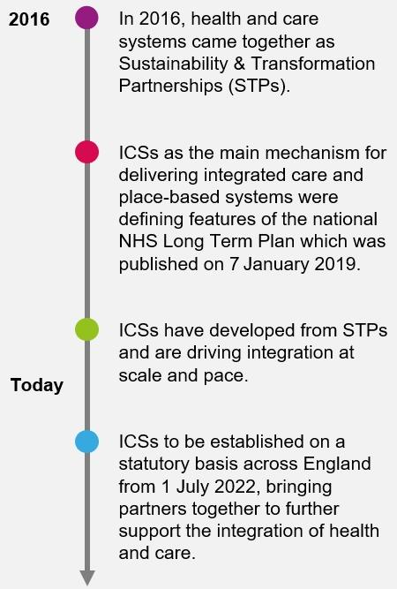
Our journey to integrated care

Slide 4
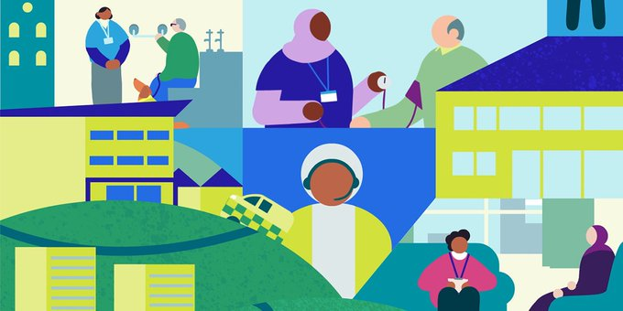
How is the NHS changing? Watch the King’s Fund video

Slide 5
How will health and care work together?
#TogetherWeAreNotts

Slide 6
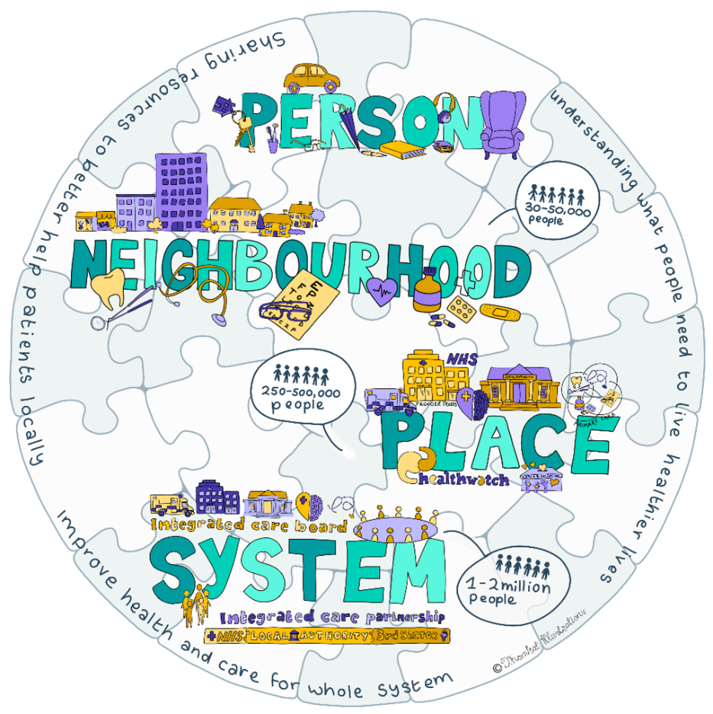
The biggest change this new way of working will bring is that the NHS and local councils – which deliver many care services – will be working together as part of a new organisation.
When the NHS was set up in the 1940s its aim was to treat symptoms. But it has come a long way since then, supporting people to live healthier lives.
This change is continuing along that journey and aims to make social care and health even more aligned.
Our health is affected by many things – housing, unemployment, financial stress, domestic abuse, poverty and lifestyle choices.
This is something that we need to look at through a partnership between the NHS, local government and the voluntary sector.

Slide 7
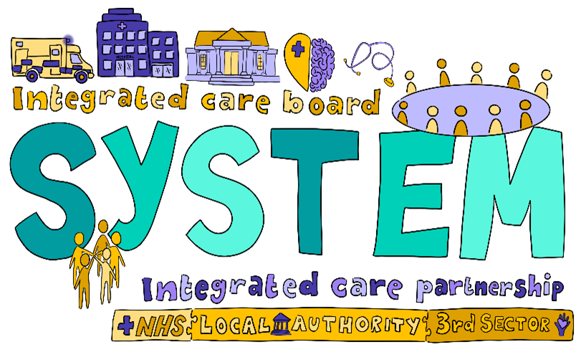
Establishing our ICS
Each Integrated Care System has two statutory elements
Integrated Care Partnership (ICP) - a statutory committee formed between the NHS Integrated Care Board and upper-tier local authorities. The ICP will bring together a broad alliance of partners concerned with improving the care, health and wellbeing of the population.
Integrated Care Board (ICB) – a statutory NHS organisation responsible for developing a plan for meeting the health needs of the population, managing the NHS budget and arranging for the provision of health services. The ICB works to deliver the ICS outcomes with partners from across our system.

Slide 8
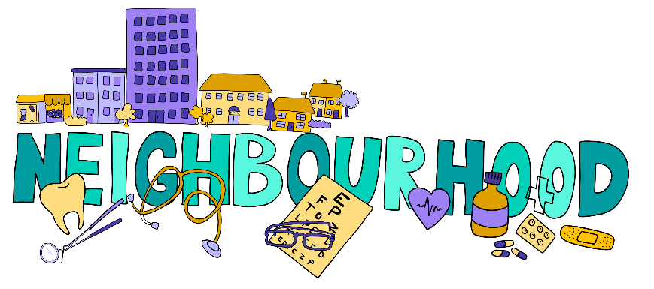
Other important features
Place-Based Partnerships will lead the detailed design and delivery of integrated services across their localities and neighbourhoods. These involve the NHS, local councils, community and voluntary organisations, local residents, people who use services, their carers and representatives and other community partners.
Provider Collaboratives will bring NHS providers together to achieve the benefits of working at scale across multiple places to improve quality, efficiency and outcomes and address unwarranted variation and inequalities in access and experience across different providers.
Local authorities in the ICS area, which are responsible for social care and public health functions as well as other vital services for local people and businesses.

Slide 9
Integration in action
Here are some fantastic examples across our system partners
#TogetherWeAreNotts

Slide 10
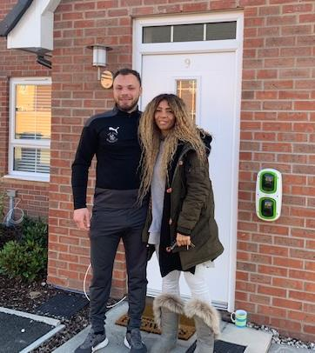
Macauley’s story
With help from the Rushcliffe social prescribing service, Macauley Diuk, 27, has embarked on an exciting new life after being homeless for four years.
His GP referred him to the service which, along with charities, helped him to move into his own home.
Macauley said: “The support I’ve received has been incredible. They have saved me. The chips were down, but they’ve lifted me up.”
Across our ICS, Link Workers are taking a holistic approach to people’s health and wellbeing. They connect people to community groups and statutory services for practical and emotional support.
Macauley and Morgan Sharpe, Social Prescribing Link Worker

Slide 11
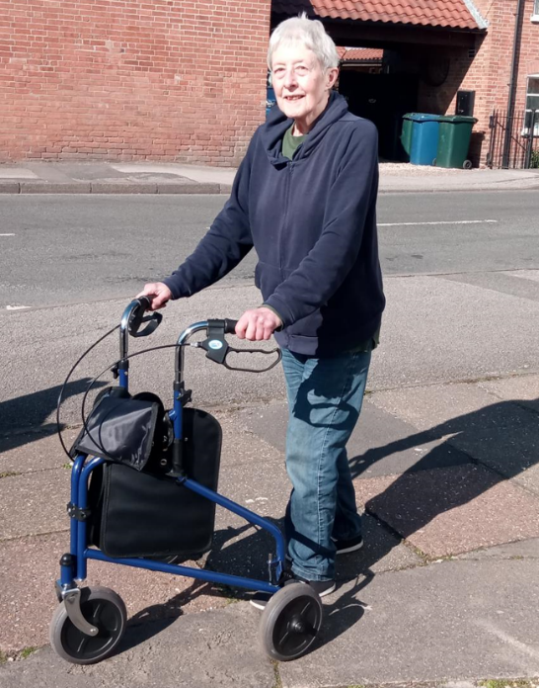
Frances’ story
Frances Latty, 76, from East Bridgford, was standing on a stool trying to change a lightbulb when she fell and suffered a stress fracture in her spine.
After hospital stay, Frances received support from the Home First Response Service which is contracted by Nottinghamshire County Council. Carers went in to support Frances with showering, dressing, shopping, support with medication and meal and drink preparation. The council also helped with equipment for her home.
Frances said: “The support has been excellent. I can put my jeans on myself now. It’s amazing, as I couldn’t do that a week ago. My brothers were amazed at the difference in my mobility and ability to care for myself.”
Frances Latty

Slide 12
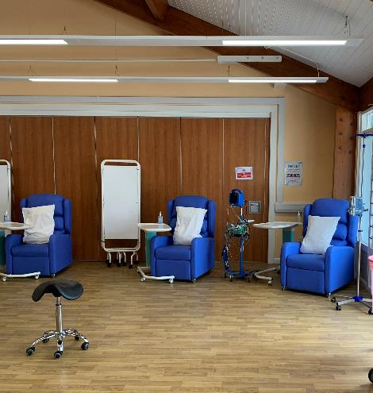
Sophia’s story
More than 1,000 people at the highest risk of becoming unwell with Covid-19 have been treated at a specialist unit.
The unit, based at Nottingham University Hospitals with an additional infusion centre at Sherwood Forest Hospitals, provides antiviral medication to high-risk Covid positive patients.
A shared system between primary care and acute hospitals flags up patients who are contacted to come forward for treatment.
Local patient, Sophia, who has Multiple Sclerosis, said about her experience: “The atmosphere that the team have created was liken to a family living room that I as a patient was joining, with jokes and laughter about who’s turn it was to make the tea. This was all alongside getting patients in, checked, canulated, monitored, answering questions and offering reassurance too. I can’t thank the team enough.”
Covid Medicines Delivery Unit at NUH

Slide 13

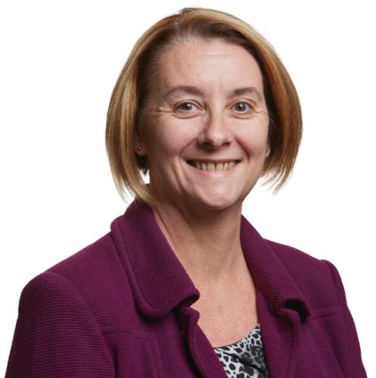
I am ambitious for our citizens. They need the best possible health and care deal. We have all the talent between us to be one of the best systems.
I see the ICS as a family and will set this tone for how we operate - all of us are equally important and we all have our roles to play.
We will need to operate as one where it matters and make the best use of our collective resources.
Amanda Sullivan
Chief Executive

Slide 14
Our family portrait - Nottingham and Nottinghamshire Integrated Care System (ICS)
Nottingham City PBP 396,000 population | South Nottinghamshire PBP 378,000 population |  |  | Mid Nottinghamshire PBP 334,000 population |  |  | Bassetlaw PBP 118,000 population
8 PCNs | 6 PCNs |  |  | 6 PCNs |  |  | 3 PCNs
NHS Nottingham and Nottinghamshire Integrated Care Board (ICB)
Nottingham University Hospitals NHS Trust |  |  |  | Sherwood Forest NHS Foundation Trust |  |  | Doncaster and Bassetlaw NHS Foundation Trust
Nottinghamshire Healthcare NHS Foundation Trust (mental health)
Nottingham CityCare Partnership (community provider) | Nottinghamshire Healthcare NHS Foundation Trust (community provider)
East Midlands Ambulance NHS Trust
Nottingham City Council (Unitary) | Nottinghamshire County Council
 | Broxtowe Borough Council | Gedling Borough Council | Rushcliffe Borough Council |  | Ashfield District Council | Mansfield District Council | Bassetlaw district Council | Newark & Sherwood District Council | Bassetlaw District Council
Voluntary and community sector input | Voluntary and community sector input |  |  | Voluntary and community sector input |  |  | Voluntary and community sector input
Our vision

Slide 15
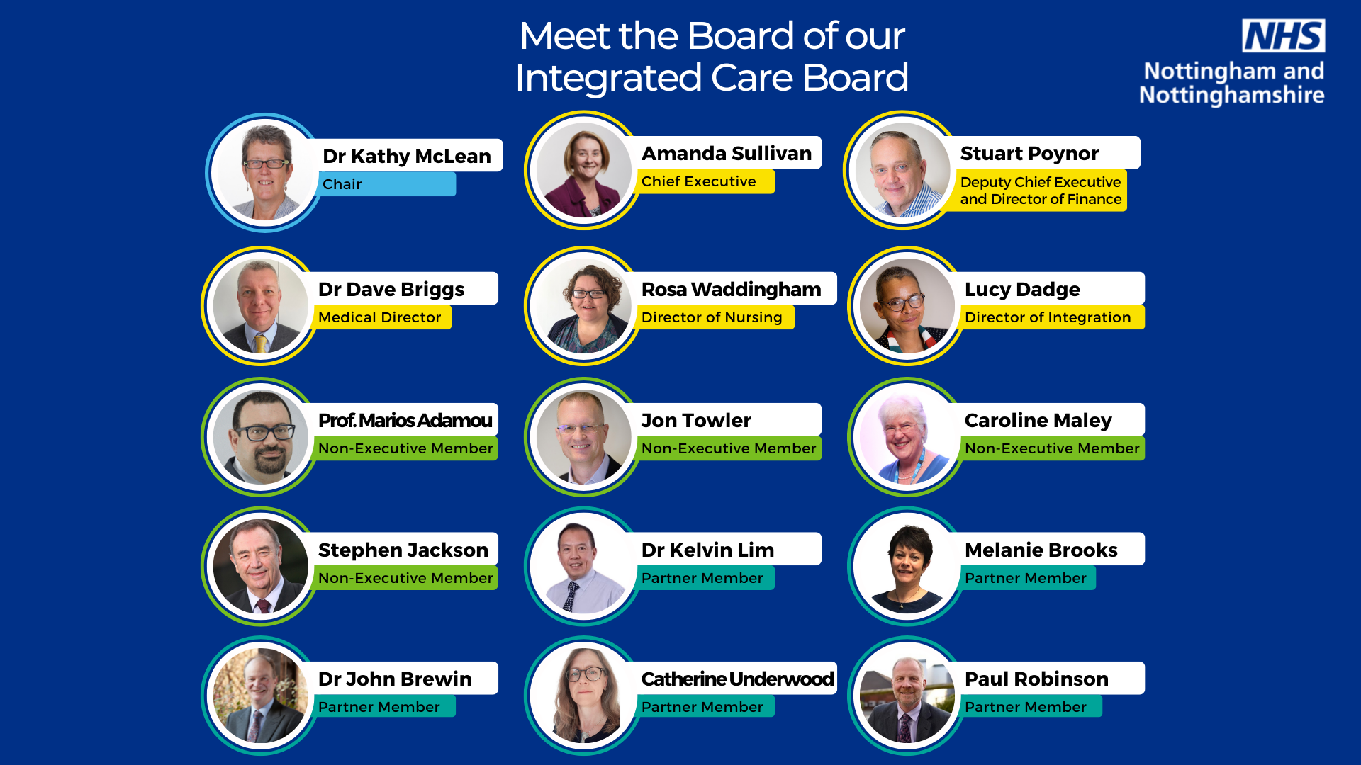

Slide 16
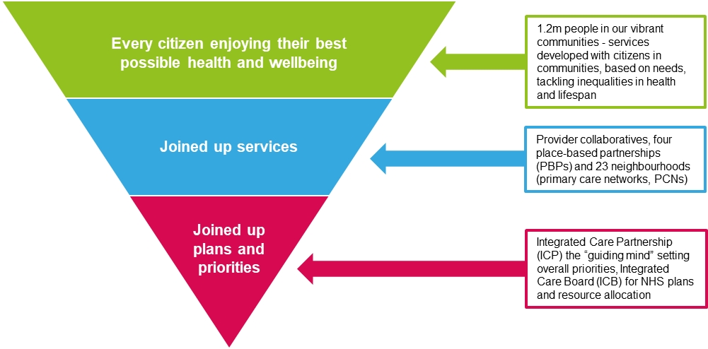
Our vision
Our neighbourhoods, places and system will seamlessly integrate to provide joined up care.
Every citizen will enjoy their best possible health and wellbeing.

Slide 17
Our principles, values
and goals
The way our ICS works together will be guided by three key principles:
We will work with, and put the needs of, our citizens at the heart of the ICS
We will be ambitious for the health and wellbeing of our local population
We will work to the principle of system by default, moving from operational silos to a system wide perspective.
Our principles will be underpinned by four core values:
We will be open and honest
We will be compassionate and respectful
We will embrace innovation
We will work collaboratively.
We must deliver each of the following goals effectively and efficiently:
Serve 1.2 million people
Support 70,000 staff in NHS and social care roles
Integrate GP Practices into 23 Primary Care Networks (PCNs)
Create four Place Based Partnerships (PBPs)
Develop a Provider Collaborative at Scale
Manage an annual budget of over £3billion for the commissioning and provision of services.

Slide 18
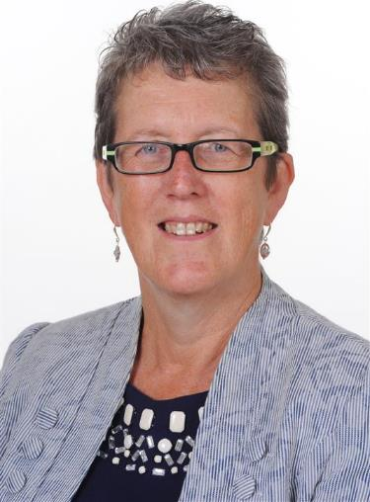
The change we want to see in our health and care system will be driven by our Places and Neighbourhoods (PCNs) – as vibrant collaboratives that can take the strategic direction and implement it creatively with our citizens and partners.
I continue to value meeting with leaders from our Voluntary, Community and Social Enterprise (VCSE) sector and Healthwatch. Working together as partners to support and challenge the development of our approaches will be a critical part of our success.
Dr Kathy McLean
Chair

Slide 19
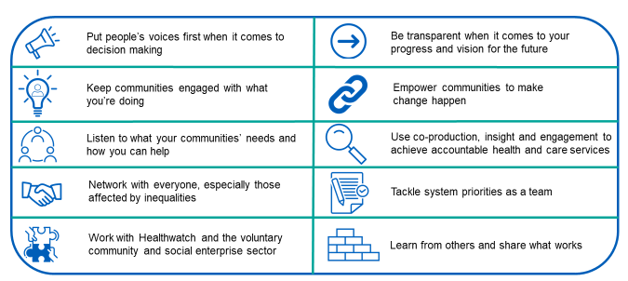
How our ICS will work with people and communities

Slide 20

Our Voluntary, community and social enterprise (VCSE) Alliance
This group of VCSE organisations across Nottingham and Nottinghamshire will act as a single point of contact to enable the generation of citizen intelligence from the groups and communities that they work with.
It’s an essential part of how the system operates at all levels, including involvement in governance structures and system workforce, population health management and service redesign work, leadership and organisational development plans.
It’s already supporting delivery of the priority objectives through the community engagement work they are commissioned to deliver.

Slide 21

What will our future look like?
We will pool our expertise, experience and efficiencies across acute, community and primary care so everyone benefits equally.
Integrated service delivery will bring together skills and expertise into multi-disciplinary teams, providing scope for new and more varied career opportunities.
The focus of service delivery will shift to become more preventative, proactive, and person-centred; focused on a specific geographic area around a common purpose to work holistically with people and communities.
Complex change across the whole system will involve everyone working in partnership to understand and resolve different ideas and perspectives.

Slide 22
Over to you
Please share this information with your teams
What does your journey look like?
Have you and your team got a great example of integrated working? Share it with us!
Get in touch:
Email: nnicb-nn.comms@nhs.net
Twitter: @Notts_ICS and @NHSNotts
www.healthandcarenotts.co.uk
#TogetherWeAreNotts

