Slide 1
Working with MNVP and Service Users - Developing DBTH Maternity Female Genital Mutilation Services
Janine Grayson
DBTH Head of Equity, Equality & Inclusivity: Maternity.
FGM Clinical Midwife DBTH
Co-chair NHSE EDI Specialist Midwives

Slide 2
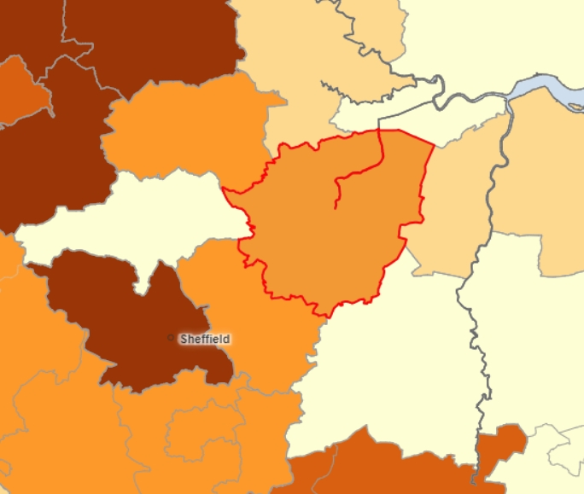
DBTH White UK Population Profile
Immigration into the UK
63% Child Bearing Age
30% < 18 years
Country of Birth DBTH (2021 census)
African – 3674
Middle East & Asian - 7237
Languages (maternity)
43 registered 6 month period
FGM Recorded DBTH
60 to 80 per annum
Doncaster: White UK population 91.8%
Bassetlaw: White UK Population
94.5%

Slide 3
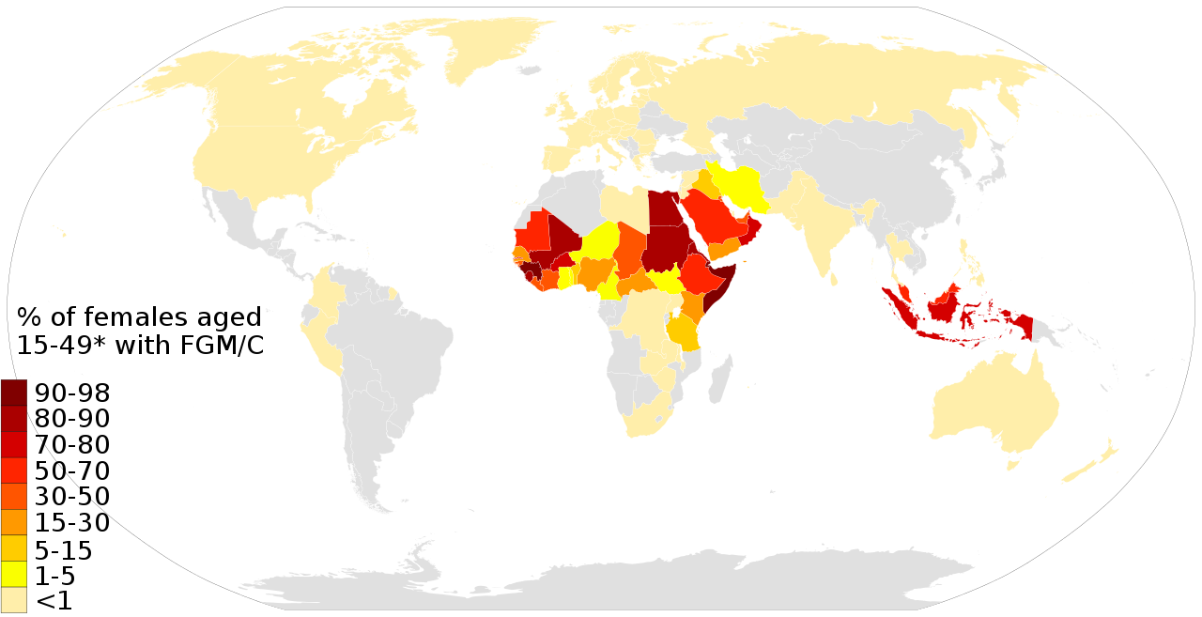
Prevalence and Prevailing Attitudes Unicef
100
80
76
65
6
5
68
60
5
4
41
4
4
40
36
37
39
29
1
9
23
20
14
15
17
11
12
13
6
6
7
8
9
9
1
2
3
3
3
0
Togo
Ghana
Iraq
Benin
Niger
Kenya
Maldives
Uganda
Eritrea
Senegal
Ethiopia
Yemen
Nigeria
Chad
Djibouti
Liberia
Sudan
Gambia
Egypt
Somalia
Guinea
Mali
Cameroon
Burkina Faso
Côte d'Ivoire
Mauritania
Sierra Leone
Central African
Guinea-Bissau
United Republic
Republic
of Tanzania

Slide 4
Co-production
Training
Resources
Information
Fear of police and social services
Previous experiences
Concerns regarding birth – elective
caesarean section
Cervical Cancer
Accessing services – Barriers
Engagement
Funding
FGM Guideline

Slide 5
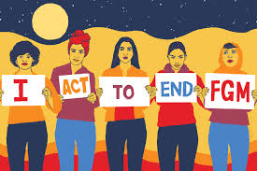
The Shamso (meaning Sun) Clinic
Tel: Antenatal Clinic DRI or email
Mobile: 07598553271 Office: 01302 648002
janine.grayson@nhs.net
Opening in September
FGM Clinic for anyone > 18yrs
Specialist Female Midwife
Doncaster ANC – First Friday of the month
Self referral or professional
Education/explanation
Clinical Assessment
Discuss safety and risks
Treatment
Referrals for additional Support
De-infibulation
https://www.youtube.com/watch?v=6Gb8bP3XGYY
https://fgmnetwork.org.uk/zero-tolerance-to-fgm-day-6th-february-2024/
https://www.unicef.org/protection/female-genital-mutilation

