Slide 1
Complex Cancer Pathway: Case Study for
Inclusion Health Conference Nottingham
Katie Baker
Complex Cancer Pathway Clinical Nurse Specialist
Cancer Centre, Nottingham University Hospitals
Katie Baker - Complex Cancer Pathway CNS – katie.baker48@nhs.net

Slide 2
First, some jargon-busting…
CNS stands for Clinical Nurse Specialist
CCP CNS = Complex Cancer Pathway CNS
USC referral = urgent suspected cancer referral (used to be two-week wait).
Cancer pathway = patient journey from referral to diagnosis and treatment.
DNA = Did not attend
NUH = Nottingham University Hospitals NHS Trust covering QMC, City and Treatment Centre
PTL = Patient tracking list, a list of all patients currently on the 62-day pathway at NUH (~4000-4500 patients)
Corporate PTL meeting = A filtered version of the big PTL focusing mainly on patients who have breached 62-day target. These patients are discussed in meetings with the speciality service managers and cancer centre managers to try and unblock pathways.
Katie Baker - Complex Cancer Pathway CNS – katie.baker48@nhs.net

Slide 3
Context for the role
Cancer nurse leadership team at NUH identified a gap in support provision for certain patient groups while on a cancer pathway.
It was felt that there is less support available for patients prior to receiving a cancer diagnosis than patients who are post-diagnosis and awaiting treatment.
Often clinical nurse specialists do not engage with patients pre-diagnosis so they can focus on patients who have confirmed cancer.
However, many patients would benefit from supportive input from the point of referral, and in some cases would be unable to engage without that support.
It was also felt that patients who are under multiple teams at the hospital would benefit from CNS oversight to co-ordinate their appointments and assist with communication between teams.
The Complex Cancer Pathway CNS (CCP CNS) started in October 2023. It was originally a secondment for one year, then extended for a further two years with funding from the Nottingham ICB.
Katie Baker - Complex Cancer Pathway CNS – katie.baker48@nhs.net

Slide 4
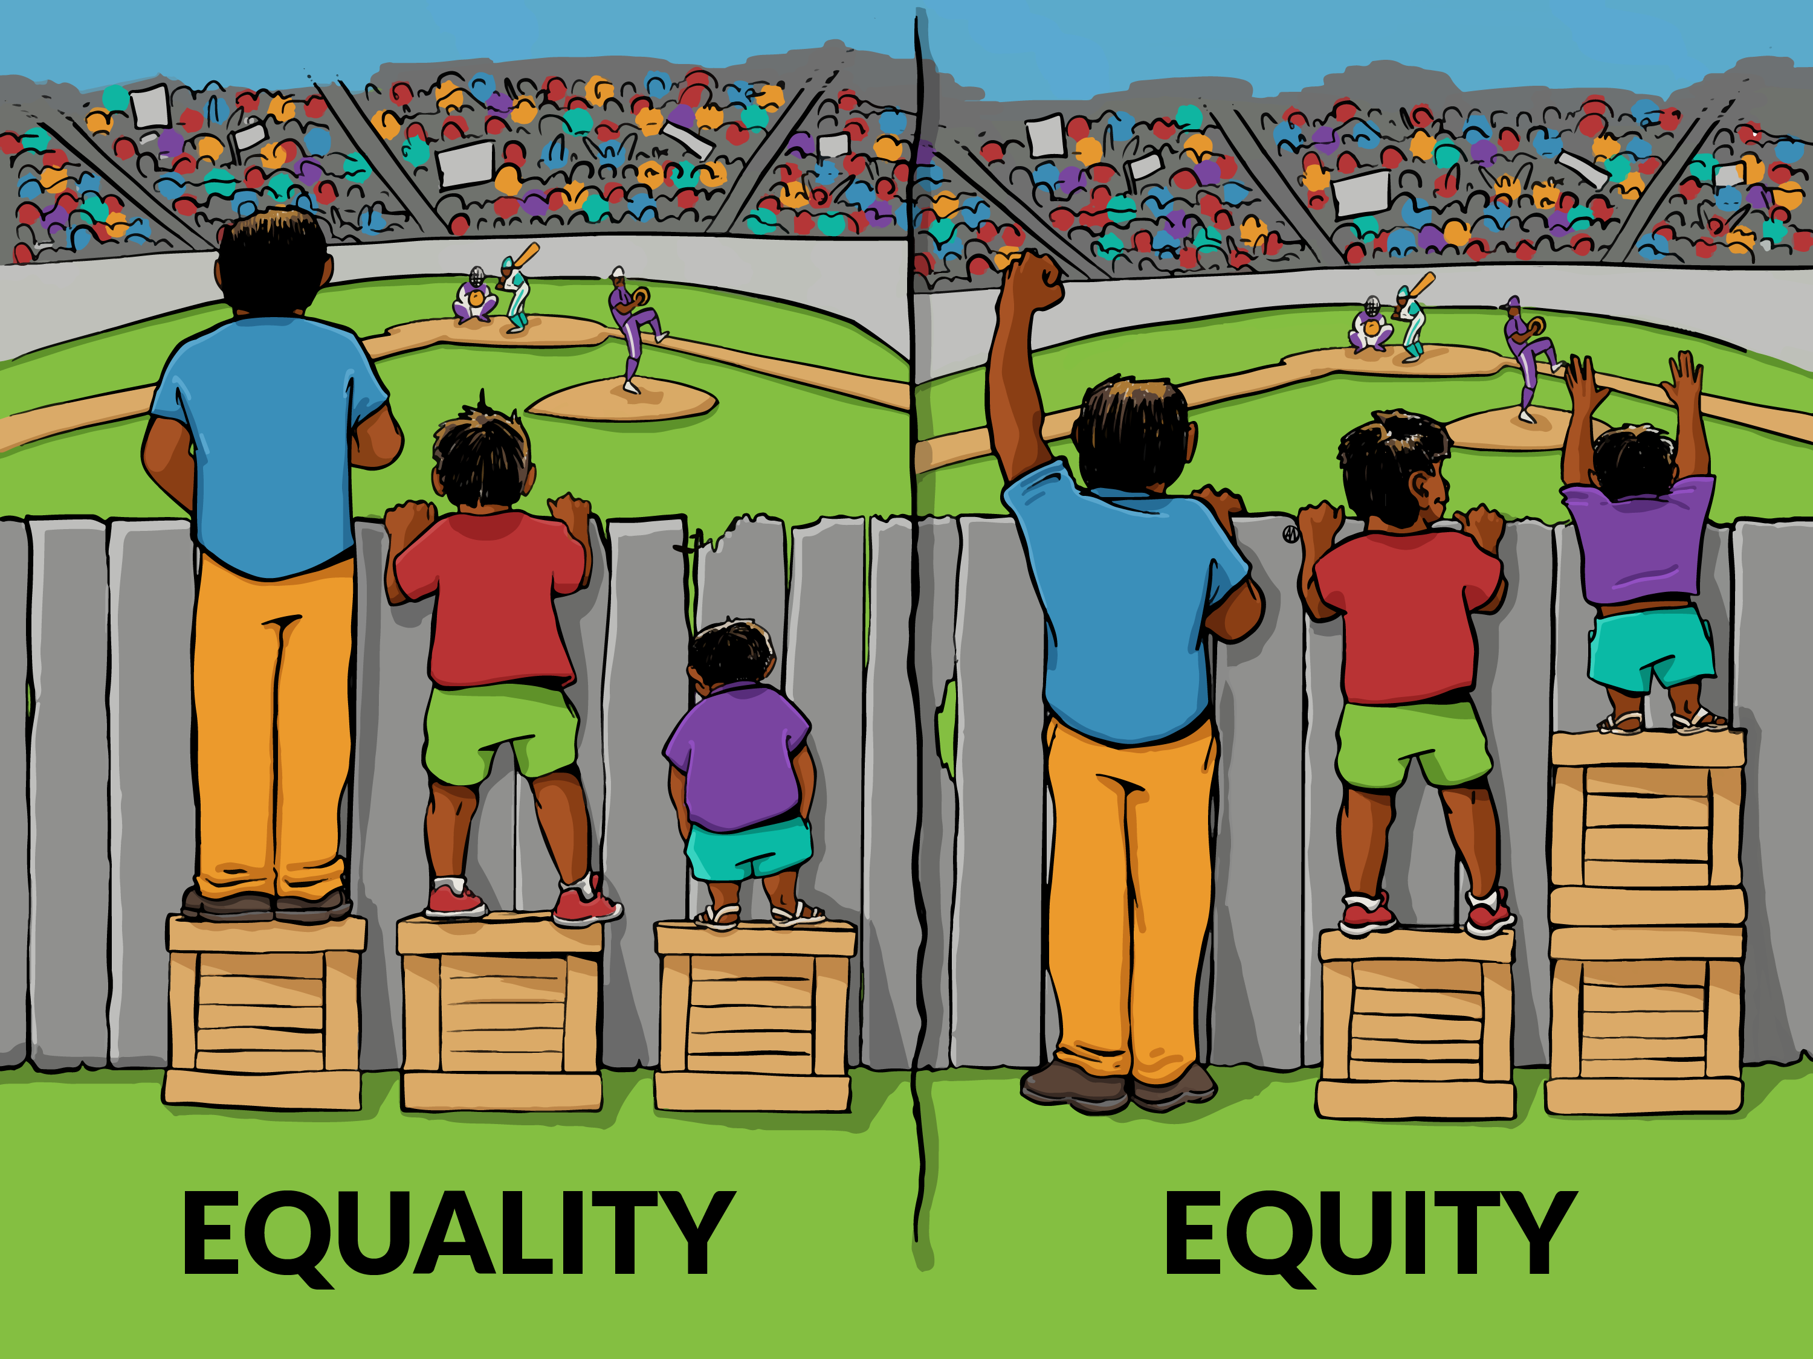
The role of the CCP CNS
Primarily focused on patients on the corporate PTL who have already breached their cancer target of 62 days.
Patients who appear disengaged (multiple DNAs, cancellations, unable to contact) are high risk for discharge back to referrer without completing diagnostics.
CCP CNS identifies patients who might be struggling and reach out to those patients by phone call.
The CCP CNS would then try to meet their support needs to enable the patient to engage and avoid discharge back to primary care where possible.
This patient contact exposed a broad range of support needs and health inequalities which disadvantage patients from accessing timely cancer diagnostics and treatment.
Katie Baker - Complex Cancer Pathway CNS – katie.baker48@nhs.net

Slide 5
Types of support offered:
Adjusting appointments
Use of telephone interpretation
Transport booking
Appointment reminders
Encourage uptake of transport cost reimbursement scheme
Referral to external service i.e. Beyond Diagnosis, Macmillan or Maggie’s
Liaison with clinical and admin teams
Referral to oncology psychology services
Liaison with key-workers
Insight visits
Chaperone appointments
Emotional support
Refer to talking therapies
Katie Baker - Complex Cancer Pathway CNS – katie.baker48@nhs.net

Slide 6
Data so far
Total pathways supported including dual pathway tracking and advisory only: 450
Total pathways with patients directly contacted by CCP CNS: 238
Total health inequality indicators identified affecting pathways: 255
Average day of pathway when CCP CNS gets involved: 84
Average days post-intervention patient pathway resolves: 37 days
This indicates that if the CCP CNS were involved earlier, patients would be more likely to reach diagnosis and/or treatment within 62 days.
Katie Baker - Complex Cancer Pathway CNS – katie.baker48@nhs.net

Slide 7
Reasons for referral for support
This graph shows the primary reason for referral to CCP CNS, however in many cases there are multiple indicators of a pathway that needs support.
For example, a complex diagnostic pathway requiring multiple procedures and scans peppered with DNAs and cancellations.
Katie Baker - Complex Cancer Pathway CNS – katie.baker48@nhs.net

Slide 8
Inclusion health concerns identified
Other barriers not included in graph:
Patient is a carer
Has a carer
Financial problems
In a care home
Dementia diagnosis
Physical disability
Ethnic minority background
Previous bad experience
Katie Baker - Complex Cancer Pathway CNS – katie.baker48@nhs.net

Slide 9
Patient example 1 – “Kathryn”
Head and neck urgent suspected cancer referral from dentist.
On pathway day 26 when referred to me and at risk of discharge due to non-engagement.
2 x DNAs already, and 3 x previous referrals closed due to DNAs.
Unable to contact on the phone.
Key support needs identified
No phone
No family support
Learning difficulty
Unable to sort transport independently
Mental health concern – significant health anxiety after loss of her mum who was previously her main support.
Katie Baker - Complex Cancer Pathway CNS – katie.baker48@nhs.net

Slide 10
Supporting “Kathryn”
I got through to the dental practice manager, whose number I found on the USC referral. She had put her own number on the most recent referral to see if it would make a difference.
Established Kathryn’s learning difficulties and frequent visits to the dental practice. We planned that the dental practice manager would phone me the next time Kathryn visited, which took a couple of weeks.
Once contact established, Kathryn warmed to me and was happy for me to support and communicate with her through the manager. She agreed to come for an appointment.
I liaised with the hospital administrative team on Kathryn’s behalf, requested a new appointment in a reasonable timeframe, booked hospital transport and chaperoned on the day.
Kathryn had a full examination and scan. No cancer was found, and she was discharged from the pathway 52 days after referral to CCP CNS having had a full assessment.
Katie Baker - Complex Cancer Pathway CNS – katie.baker48@nhs.net

Slide 11
Patient example 2: “Andy”
Andy was on two cancer pathways on referral to CCP CNS, both on day 33.
Multiple DNAs across both pathways.
Key support needs identified
Registered blind
Could not make phone calls or read letters due to blindness
Aged 93
Mobility problems
Transport issues
No family support, lives alone
Complex dual pathways ongoing
Katie Baker - Complex Cancer Pathway CNS – katie.baker48@nhs.net

Slide 12
Supporting Andy
Regular appointment reminders
Transport bookings on his behalf
Regular phone calls to check in
Read his clinic letters out to him on the phone
Converted appointments to telephone where appropriate
Chaperoned appointments.
Referred to Beyond Diagnosis for support at home
Referred to practice nurses for continence support
Andy was diagnosed with colorectal cancer and chose palliative treatment; however, he is still alive and well. Since the Salvation Army helped Andy to contact his estranged son, he now enjoys a fulfilling relationship with his son, daughter-in-law and grandchildren.
Katie Baker - Complex Cancer Pathway CNS – katie.baker48@nhs.net

Slide 13
Patient example 3: “Craig”
Referred by specialist nurses. Difficulty contacting Craig on the phone.
4 x DNAs, 1 x attended appointment. High risk for cancer, team very concerned.
I phoned Craig about 7 times over several days and eventually made contact.
He agreed to a further appointment and apologised for DNAs.
Key support needs identified
Alcohol use, starts drinking from the morning
Financial problems, on benefits
Some indication from nursing team of aggressive behaviour towards staff
Katie Baker - Complex Cancer Pathway CNS – katie.baker48@nhs.net

Slide 14
Supporting Craig
I told Craig about the travel cost reimbursement scheme which he qualifies for because he is on benefits .
Offered referral to alcohol recovery services.
Contacted Craig ahead of new appointment to remind him, but he still DNA’d.
We tried again. For his next appointment, I rang him at 9am on the day, and then again two hours later. The first call woke him up, and the second call prompted him to leave the house.
Craig was really struggling with his drinking, and the prompting helped him remember the appointment.
Once he attended, they repeated his biopsy, referred him to recovery services and got his travel costs reimbursed, which he was very happy about.
He now receives support from the speciality CNS team and is engaged with them.
Still awaiting final histology so unknown if confirmed cancer or cancer excluded at this time.
Katie Baker - Complex Cancer Pathway CNS – katie.baker48@nhs.net

Slide 15
What have we learnt?
Katie Baker - Complex Cancer Pathway CNS – katie.baker48@nhs.net

Slide 16
What have we learnt?
Patients don’t DNA appointments to deliberately waste NHS time. There is usually a very good reason or a support need behind every DNA.
It is simply not enough to send someone an appointment in the post.
We must challenge attitudes that place responsibility back onto the patient without exploring their support needs first.
Avoid expecting patients to respond to the health information the way we would ourselves.
A flexible, personalised approach is best.
For many patients, cancer is not the first thing on their mind, so it’s more important to work alongside that patient to make their cancer pathway fit into their other priorities.
Technical medical language is exclusive and does not cater to the needs of our population and their level of health literacy. We would like to influence changing all our medical letters to have a reduced reading age to match the reading age of our population – including outside of cancer.
Empathy goes a long way.
Not using withheld caller ID – patients call me back!
Patients appreciate having a person they can call easily.
By meeting the needs of the most disadvantaged we improve accessibility for everyone.
Katie Baker - Complex Cancer Pathway CNS – katie.baker48@nhs.net

Slide 17
Evolution of the role and future aspirations…
Within the first three months, it was felt we needed a system to identify patients at the point of referral.
It is impossible, currently, to know which patients have the highest support needs.
CCP CNS is trialling a focus on patients at day 0-10 of their pathway who have missed their first appointment. This is to explore whether this enables identification of patients with barriers to access earlier on in their pathway.
New links with Nottingham Wellbeing Hub and Nottingham Recovery Network to provide joined-up support for patients affected by substance use and cancer.
Started a collaborative project with the Mary Potter Centre where if a GP feels a patient will struggle to engage with cancer services, they can refer to the CCP CNS at the same time as submitting USC referral - hoping to extend to more practices soon.
Aim to start using eHealthscope in the future to stratify risk of disengagement for new cancer referrals.
Roll out inclusion health training for staff working in cancer specialties.
Katie Baker - Complex Cancer Pathway CNS – katie.baker48@nhs.net

Slide 18
Thank you!
Contact details:
Katie Baker
Katie.baker48@nhs.net
07812277912
0115 969 1169 ext. 78367
Referral criteria:
Patient is on an active cancer pathway
Patient is over 18
Identified barrier, delay or blockage affecting patient’s ability to access cancer services.
Katie Baker - Complex Cancer Pathway CNS – katie.baker48@nhs.net

