Slide 1
Nottingham and Nottinghamshire Integrated Care System
Data, Analytics, Information and Technology (DAIT) Strategy
2020-2024
13 August 2020 v3.1

Slide 2
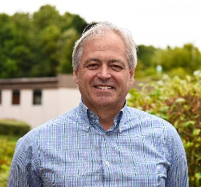
Foreword
Across Nottingham and Nottinghamshire there are more people living longer in ill health, unprecedented levels of demand for care and support, workforce shortages and considerable funding constraints. Combined these factors continue to place an ever-increasing strain on the local health and care system and looking to continue to do more and more of the same each year is not sustainable.
In response to this the leaders of our local health and care system have come together to develop a five-year strategic plan, underpinned by the ICS Clinical and Community Services Strategy, that sets out a shared vision to ‘both increase the duration of people’s lives and to improve those additional years, allowing people to live longer, happier, healthier and more independently into their old age’. Delivery of this vision will be characterised by moving from a health and care system that is often siloed and reactive in nature to one where all partners are focused on the entire spectrum of interventions from prevention and promotion to health protection, diagnosis, treatment and care – and integrates and balances action between them.
However, we recognise that without the right digital systems, or data, analytics, information and technology, this transformation risks being limited both in scale and the overall impact it has on our population. We recognise there is a critical relationship between high levels of digital maturity and service transformation and that we need to plan and deliver both in tandem in order to deliver our long term vision. In doing so we aim to:
Define key areas of digital priorities that we need to invest in to support long-term transformation and deliver the LTP and our five-year strategic plan
Provide a structured approach to digital strategy development that helps the ICS find the right balance of investment across these priorities and other local needs
This strategy is designed to help establish a shared commitment and vision for digitally-enabled transformation across the health & care system. The strategy builds on the significant increase in pace of digital transformation in response to COVID-19, and it supports the ICS Clinical and Community Services Strategy and the five year strategic plan. As recovery plans become clearer and have an impact on existing organisations’ strategies, the strategy will iterate to reflect those changes.
Dr Andy Haynes
ICS Executive Lead
SRO Data, Analytics, Information and Technology
Successful Digital Transformation:
Everyone is treated as an individual, given the tools to stay healthy and supported in their own homes, and to drive their own care when they need it
Every health and care professional is able to operate at the top of their capability, with the time they need to care for people
The system can optimise the care it provides through data, analytics and research, and services can be planned and commissioned more efficiently

Slide 3
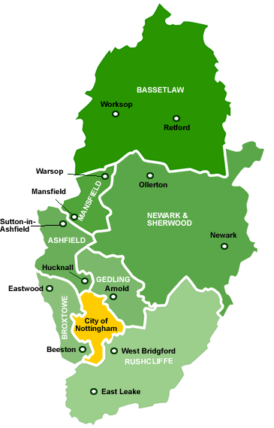
The context for this strategy
Overview
Our health and care partners across Nottingham and Nottinghamshire came together in 2016 in a Sustainability and Transformation Partnership (STP) with the collective goal of improving the quality and sustainability of health and care services.
This collaboration subsequently evolved into an Integrated Care System (ICS) in 2018 focussed on becoming a fully population health focused health and care system – a system where all partners are focused on the entire spectrum of interventions, from prevention and promotion to health protection, diagnosis, treatment and care; and integrates and balances action between them.
Challenges to be addressed
The key challenges faced and therefore to be addressed by the Nottingham and Nottinghamshire Integrated Care System can be grouped into three categories, that have a reinforcing effect on each other: the health and wellbeing of the population, the provision of services and the effective utilisation of health and care system resources.
Health and Wellbeing
More people are living longer in ill health
Deprived communities have greatest exposure to factors that impact adversely on health
COVID has potentially widened the health inequalities gap
Current health & care services have been set up to help sick people get well, often in a hospital setting
Do not routinely and systematically identify and support people with ongoing needs
Do not use digital services well in health and care
Increasing vacancies in health and care workforce
Ageing estate with high level of backlog maintenance
Significant financial deficit forecast over next 5yrs, underpinned by recurrent deficit, non-delivery of savings plans and increasing activity/demand
ICS members include:
Nottingham City Council
Nottinghamshire County Council
City Care
Nottingham and Nottinghamshire CCG
Nottingham University Hospitals NHS Trust
Sherwood Forest NHS Foundation Trust
Nottingham Healthcare NHS Foundation Trust
Service Provision
Resource Utilisation
This document describes the over-arching data, analytics, information and technology (DAIT) strategy to support the Nottingham and Nottinghamshire ICS address these challenges
The ICS covers a diverse population of over 1 million people living in the City of Nottingham (332,000) and Nottinghamshire County (764,700), however this does not include the residents of Bassetlaw as they are part of the South Yorkshire and Bassetlaw health care system

Slide 4
If we get this right how will it feel for people
As a citizen living in Nottingham and Nottinghamshire this means:
We will support our population by providing them with the skills, training and tools to access digital health and care services in order to empower and enable them to manage their health and care and reduce health inequalities and social isolation.
We will not worsen digital inequalities; we will work to reduce them
We will provide our population with public facing digital health and care service to enable them to access health and care services digitally from a single trusted place and provide them with the information they need about their health and care and community services.
We will reduce the number of times people have to repeat themselves to health and care services - by making the right information available at the right time.
As a person receiving support from our health and care system:
You will be able to communicate with health and care professionals through a single secure application, the NHS App. You will be provided with a range of information and online services to support the delivery of your health and care services.
We will improve how we proactively identify the health and care needs of our population in order to identify and put in place support and treatment that our population need in order to stay well.
Your data is captured by electronic health and care systems which will be interoperable to make clinical information visible to professionals and service users where required. Information will be held and moved safely with regular testing to ensure that the systems are secure.
As a person working in our health and care system:
We will provide support and training to our health and care professionals to develop the skills that they need to use digital technology in order to enable them to undertake their job to the best of their ability.
All health and care professionals will have the right tools to do their job and will be supported by digital infrastructure to deliver services in any of our buildings, community and people’s homes.
We will provide the people involved in providing health and care with the information they need in one place to enable them to provide the most appropriate health and care to our population.
Our vision for DAIT is therefore for our citizens and service users to engage with us digitally and for our front line professionals to be supported by digital systems to make their work easier by giving them access to everything they need

Slide 5
Where we are starting from (the digital / DAIT context)
Digital Transformation
Digital Evolution
Digital Revolution
Accessibility and availability of digital health and care sporadic and silo’d
Overall utilisation of population facing digital services low
Value of digital health and care recognised and underpinned by national policy
Need to increase investment in digital technology through transformation, current baseline spend c. 1-1.5%
The Covid-19 period of February to May 2020 saw a shift change in the use and adoption of digital technology across Health and Care, with an additional £2.5 million invested in digital services
This change has seen the adoption of new models of care to manage people digitally
Expansion of online and remote consultations and monitoring of people
Empower and enable people to manage their health and care in order to self manage, self monitor and self serve
Use of intelligence, analytics and behaviour insights target service and resources
178%
increase in NHS App login from February 2020 to May 2020 **
Of people in Nottingham or Nottinghamshire had used digital to monitor their health conditions *
73%
Of people in Nottingham or Nottinghamshire would like access to digital service to manage their health *
30%
Of people in Nottingham or Nottinghamshire had accessed appointments via video consultation *
10%
Of people in Nottingham or Nottinghamshire would like to access health and care appointments via video consultation *
59%
NHS App
Of people in Nottingham or Nottinghamshire had accessed directories of services online *
193% increase in NHS App registrations during Covid-19 **
In order to revolutionise digital across the system we need to increase and enable;
The accessibility and availability of digital technologies to our people to enable online and remote consultations and information
The utilisation of data, analytics, intelligence and behavioural insights to improve health inequalities and provide personalised care
Digital first models of care, including full electronic records in hospitals and elsewhere
A single digital health and care record
Empowered and skilled workforce
Investment in digital technology to deliver service transformation and maximise benefits for the people of Nottinghamshire
45%
Feb 2020 May 2020
In Nottingham and Nottinghamshire historically 30% of people used digital health and care services*
In Nottingham and Nottinghamshire this increases to 73% for people expectations in future *
14.2K 41.3k
259% increase in online prescriptions ordered during Covid-19 **
Feb 2020 May 2020
30%
73%
1,661 Online Prescriptions Ordered
5,956 Online Prescriptions Ordered
Connected Nottinghamshire public engagement and research [2018]. Insights gathered pre Covid-19 with Board commitment to re-evaluation of position post Covid-19
** Information Source NHS App [June 2020]

Slide 6
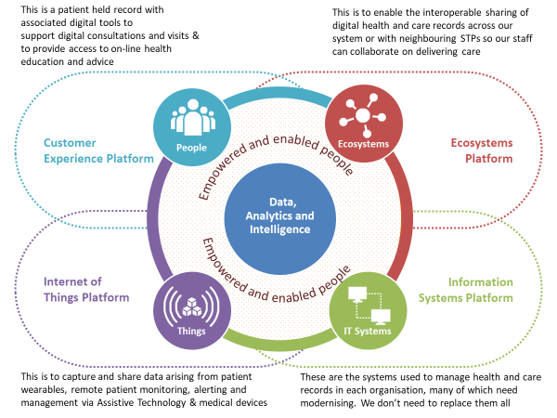
What is the basis of our DAIT strategy?
What do we mean by ‘DAIT’
We have developed our definition of Data, Analytics, Information and Technology (DAIT) from Gartner – the well-respected global digital research company - in the picture below. It encompasses the business context, the technology, the data management, the information creation and the analytics to deliver the best customer experience to the people we serve.
Our DAIT strategic initiatives
In line with our definition of DAIT, the challenges we face and the known expectations on our health and care systems partners we have defined five strategic initiatives to drive forward our strategy.
DAIT Strategic initiative
1. Develop our Public Facing Digital Services
Develop our Population Health Management capability, aligned with powerful Analytics and Intelligence to support all initiatives
Complete the digitisation of providers by 2024
Develop a single summary health and care record and supported workflows, by interoperability of our health and care data and systems
Improve the digital literacy of the workforce and the capability and capacity of our digital and informatics specialists and develop our culture, investment and governance

Slide 7
DAIT objectives and how they support the system
Strategic initiative | Strategic objectives | System Challenges
 |  | HWB | SP | RU
Develop our public facing digital services | Digital contact becomes the default route for public to engage with services Create Digital Health and Care People Senate |  | 
Develop our Population Health Management (PHM) capability, aligned with powerful Analytics and Intelligence to support all our initiatives | Ensure PHM approach is supported with appropriate resources including better analytics, tools and techniques , which will support all initiatives Establish a Health and Care Analytics Collaborative Build on our Track & Trace capability Embed a systematic approach to developing & monitoring system outcomes and proactively finding and enabling new interventions Augment artificial intelligence and human skills in designing care services |  |  | 
Complete the digitisation of providers by 2024 | Support the delivery of the ICS Clinical Services and Community Services Strategy through the continued implementation of technology enabled care Implement full EPRs in Acute care and implement the GP IT Futures Programme Enable all staff to work in any location as appropriate Rationalise and modernise diagnostic services and reporting Enable the visibility of capacity across all care settings and the ability to schedule the move of patients quickly Roll-out of electronic prescribing and drug administration |  | 
Develop a single summary health and care record and supported workflows, by interoperability of our health and care data and systems | Single health and care record available to all staff Agree and embed system wide standards for data capture and exchange Ensure consistent capture and availability of patient’s wishes |  |  | 
Improve the digital literacy of the workforce, and the capability and capacity of our digital and informatics specialists and develop our culture, investment and governance | Create a mechanism for sustained investment (aligned with five year strategic plan) Increase the digitally literacy of our workforce, including the skills of managers in interpreting new methods of presenting complex information Develop a workforce plan for digital specialists Develop governance arrangements to include a Digital Design Authority |  |  | 

Slide 8
2020
2021/23
2023/25
Stabilise Population Health Management processes
Digital contact becomes the default route for the public to engage
Personalised Health & Care Services designed for our population
Delivering outstanding Digital Health & Care
Agreed approach to developing outcome measures
Create an augmented intelligence solution for care design
Build on Track & Trace technologies for future health & care benefit
Health & Care service provision fully exploits digital services eg EPR
Nottingham & Nottinghamshire
Digital Health & Care Roadmap
Integrated health & care Digital records & technologies deployed
Affordable and sustainable digital care delivered across the ICS
Ongoing digital transformation projects by the Notts Digital Collaborative
Integrated health & care analytics technologies deployed
Build common service platforms to exploit integration
Increase investment in Digital as per 5yr Plan with 3x Return
Establish the Notts Health & Care Analytics
Collaborative
Create the Digital Health & Care People Senate
Create a Digital Design Authority mechanism
Create a workforce plan for Digital specialists
Establish sustainable Digital investment at system level

Slide 9
Ensuring Delivery of our Strategy (1)
1. Clear Expectations
A Digital Health & Care People Senate will ensure everyone involved in the ICS; including the general population, people using services, people providing health and care services or people delivering technologies; will be able to shape those services and have a personal investment in their success.
All ICS organisations will have an Executive Level champion committed to the collaborative DAIT Agenda as Senior Responsible Owner for their organisation with authority to make decisions.
All strategies for health and care delivery across Nottingham & Nottinghamshire will include a ‘Digital First’ perspective.
2. Sustainable Delivery
Careful investment in modern & secure technology improves care, increases productivity, reduces the burden on our workforce freeing up more time to care, helps manage demand by enabling care to take place in the right setting and improves patient experience.
DAIT is a key enabler of the five-year strategic plan and the system operational plan. Resources will be reviewed (capital & revenue) to ensure appropriate levels of investment in technology are made in health and care services by 2024.
We will robustly evaluate what we have done and what we said we would do, and publish it.
The system will continue to work together to bid for NHS Targeted Transformational Funding.
Recognising the financial challenges, a robust approach to benefits realisation will be used. The target return on investment will be at least 3x cost, with a proportion re-invested for further benefits.
1. Clear Expectations
Invested
people
Active ICS &
Board support
2. Sustainable Delivery
Long-term resource
Investments
Strong benefits
management
3. Good Governance
Clear programme
delivery
Commitment to
collaboration

Slide 10
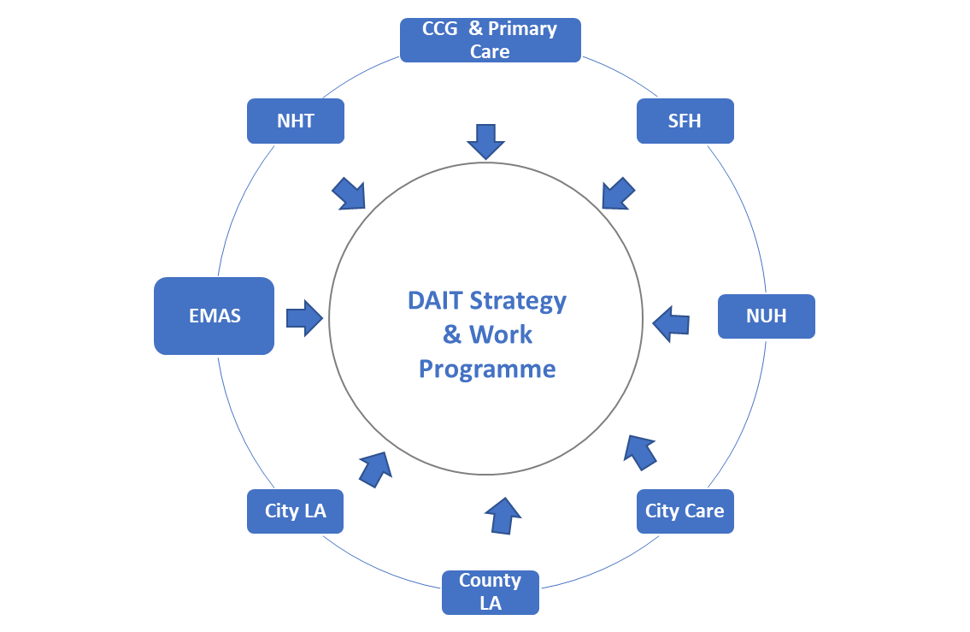
Ensuring Delivery of our Strategy (2)
ICS Board
3. Good Governance
The System-wide Stakeholder Board (DAIT) will have three key roles for the health and care system:
System Partnership & Decision Making
Strategic Direction
Oversight and Assurance : Programme Implementation
System level digital transformation projects will be delivered through the Digital Health & Care Collaborative, for example PFDS & digital inclusion, capacity & flow and health & care community portal.
A collaborative approach for system data, analytics & information will also be set up, building on the learning from the Nottinghamshire Health & Care Data Cell established as part of the COVID-19 response
The DAIT strategy and work programme will be delivered through professionally managed programmes of work to ensure progress towards our goals
The top 3 barriers to implementation are Commitment, Money and Culture. We will address these barriers by having:
A robust business case process to underpin any investment
A risk management process that ensures that risks, issues, actions and decisions are managed by the Stakeholder Board
Escalation mechanisms will be in place through the System-wide Stakeholder Board; and ultimately the ICS Board for resolution
System wide Stakeholder Board for DAIT
DIGITAL TRANSFORMATION PROGRAMME
(Health & Care Digital Collaborative)
SYSTEM DATA, ANALYTICS & INFORMATION
(Health & Care)
ICS members collaborate to deliver strategy
Working closely with stakeholders is key to successful delivery
District & Borough Councils
NEMS
Care Homes
Third Sector

Slide 11
Glossary
Acronym / abbreviation | Explanation
Apps | Short for ‘application’. Refers to a programme or piece of software, in particular on a mobile device
Artificial Intelligence (AI) | Technology operating in a way that would require intelligence if performed by humans
Assistive Technology | Devices & technologies which help people to stay safe in their own home & increase their ability to self-manage. Includes capabilities such as telehealth, telecare, telemedicine, smart home technology, motion detectors, wearable devices & in the future more advanced digital technology such as robots & the internet of things (see below)
Cloud-first | Considering in the first instance and primarily using systems and storage that are hosted and accessed remotely
Digital / Digital Transformation | Computer-based products, solutions, systems and approaches; Digital Transformation is the use of frequently changing digital technology to solve problems, transforming processes that were non-digital or manual to digital processes. Locally, the term Digital is interchangeable with DAIT
Electronic Patient Records (EPR) | Patient health and care information recorded and available digitally
Fast Healthcare Interoperability Resource (FHIR) | The industry standard for exchanging information between healthcare systems
Health and Well Being (HWB) | Health is a state of complete physical, mental and social well-being and not merely the absence of disease or infirmity (WHO’s definition); one of the 3 challenges to be addressed by the ICS and the thread coloured green in this strategy
Integrated Care Partnership (ICP) | A partnership that brings together health and social care services to meet the needs of the local population
Integrated Care System (ICS) | A partnership across Nottinghamshire, consisting of three ICPs, setting the goals and strategy for health and care
Internet of Things (IoT) | IoT describes a scenario where digitally enabled resources or assets (e.g. devices, cars or buildings) are connected to a network that enables them to link, interact and exchange data
Interoperable | Systems and software that can communicate, share data and work efficiently with one another.
Longitudinal Health Care Record (LHCR) | These enable an individual’s health and care information to be shared as they move across the NHS and social care. In our region this is known as East Midlands One-Care
Machine learning | The process by which systems automatically learn from data / experience without human intervention
Mobile-first | Primarily using and considering mobile devices for capturing, using and interacting with information
NHS App | A mobile application through which citizens can access a range of NHS services
Platform | A platform is a mixture of hardware, software and digital services on which to base applications, processes or technologies. Each platform has its own set of rules that dictate how they should work. They can support one organisation or many organisations; in our usage here they support many organisations, forming part of a business ecosystem which shares data securely with other organisations using agreed rules, standards and protocols. Alibaba and Amazon are examples of platforms that support an ecosystem linking millions of individuals and organisations.
Population Health Management | Using information and insight to understand the needs of populations and target resources and interventions accordingly
Resource Utilisation (RU) | How we deploy our workforce, finance and estates in delivering services, one of the 3 challenges to be addressed by the ICS, and the thread coloured purple in this strategy
Service Provision (SP) | Provision of health and care services, one of the 3 challenges to be addressed by the ICS and the thread coloured blue running through this strategy

